Slide 1
Chapter 1: Introducing Financial Accounting

Slide 2
Table of Contents
1. Demand for Accounting Information
2. Business Activities
3. Financial Statements and The Accounting Equation
4. Deep Dive: The Four Core Statements
5. The Financial Reporting Environment
6. Analyzing Financial Statements (Ratios)
Notes:
We will move through six sections, starting with why we need accounting information, moving through the mechanics of the statements, and finishing with how to analyze those statements using ratios like ROE.

Slide 3
1. Demand for Accounting Information

Slide 4
What is Accounting?
Definition
  A system of recording, summarizing, and analyzing financial transactions.
Purpose
  To provide useful information for economic decisions.
Two Categories:
  Financial Accounting: External users (Investors, Creditors).
  Managerial Accounting: Internal users (Management, Operations).
Notes:
Accounting is more than just math; it is a system of communication. The key distinction is the audience. Financial accounting targets outside decision-makers like banks and shareholders, whereas Managerial accounting is for the internal team running the business.

Slide 5
Information Needs of Decision Makers
Financial Accounting
Managerial Accounting
Who are the Decision Makers?
Investors and analysts
Creditors
Suppliers and customers
Top management
Marketing Teams
Production and operations
What Decisions are Made?
Buy and sell stock?
Lend or not?
Purchase/sell goods or not?
Develop new strategy?
Launch a new product or not?
Manage operations
What Information is Needed?
Sales and costs
Cash in and cash out
Assets and liabilities
Product sales and costs
Department performance
Budgets and quality reports
Notes:
Short Speaker Notes
“This slide highlights the key difference between financial and managerial accounting.”
Who uses the information?
Financial accounting serves external users—investors, lenders, regulators.
Managerial accounting is for internal users—managers who run the business day-to-day.
What decisions are supported?
Financial accounting helps outsiders assess performance, profitability, and overall financial health.
Managerial accounting supports operational decisions—pricing, budgeting, planning, and controlling costs.
What information is used?
Financial accounting relies on historical, GAAP-based, company-wide data.
Managerial accounting uses future-oriented, flexible, detailed information—whatever managers need.
“So in short: financial accounting looks outward and backward; managerial accounting looks inward and forward.”

Slide 6
Users of Accounting Information
Business
Current shareholders & Directors
Potential shareholders
Government agencies
Suppliers
Customers
Manager & Employees
Creditors
Financial analysts
Notes:
Different users have different needs. Shareholders want to know if they should invest. Creditors, like banks, just want to know if they will get their money back. Analysts act as intermediaries, interpreting this complex info for the market.
Shareholders & Potential Shareholders
Use info to decide whether to invest or keep investing.
Rely on financial statements to evaluate company performance since they don’t manage operations.
Creditors & Suppliers
Banks, lenders, and suppliers assess ability to repay loans or honor contracts.
Financial info helps determine credit terms, interest rates, and supplier relationships.
Managers & Directors
Use statements as a performance “report card.”
Boards review operations and strategy; managers use info for planning, bonuses, and comparisons with other companies.

Slide 7
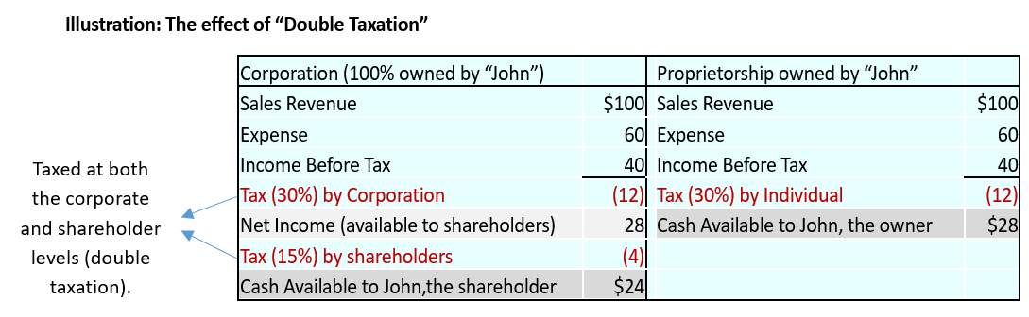
Forms of Business Organization
Sole Proprietorship Owned by one person; owner takes all risk.
Partnership Owned by 2+ people; share profits/losses.
Corporation Separate legal entity.
  Advantage - Limited liability, easier to raise capital.
  Disadvantage: Double taxation.
Notes:
For accounting purposes, the Corporation is the most complex but allows for limited liability. This means owners can only lose what they invest, not their personal assets. However, they face double taxation on profits and dividends.

Slide 8
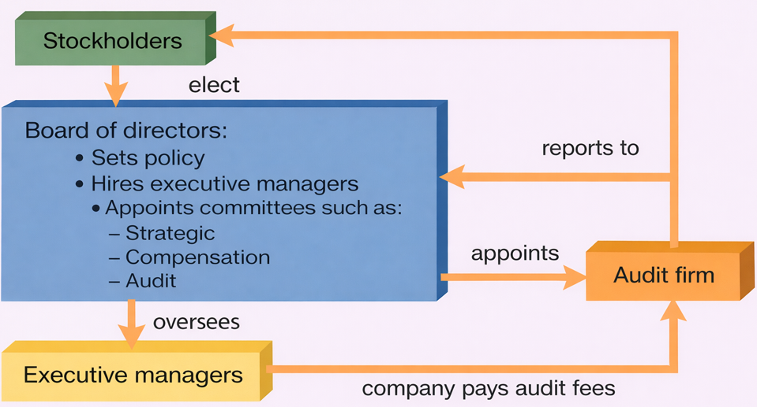
Corporate Governance Structure
Notes:
“This diagram shows how corporate governance works.”
Stockholders elect the Board of Directors.
The Board sets policy, hires top executives, and forms key committees like audit, compensation, and strategy.
Executive managers run the day-to-day business and report back to the board.
The Audit Committee appoints the external Audit Firm, which examines the company’s financial statements.
Even though the company pays the audit fees, the auditor reports directly to the board, helping maintain independence.
“Overall, it’s a system of checks and balances: owners oversee the board, the board oversees management, and auditors help ensure honest financial reporting.”

Slide 9
The Supply of Information
Primary Source of Accounting Information for Public companies
  10-K: Audited annual report (most comprehensive source)
  10-Q: Unaudited quarterly report (timely updates)
Why Companies Disclose more Information than Required
  Firms provide accounting data when benefits exceed costs
Notes:
*Together, these filings are the main accounting information available to investors, analysts, and the public.

Slide 10
The Supply of Information (continued)
Benefits of Disclosure
Lowers cost of capital (cheaper debt/equity)
Strengthens supplier and customer relationships
Increases market visibility
Costs of Disclosure
Preparation & compliance costs (audits, SEC filings).
Competitive risk from revealing strategy.
Notes:
*Together, these filings are the main accounting information available to investors, analysts, and the public.

Slide 11
2. Business Activities

Slide 12
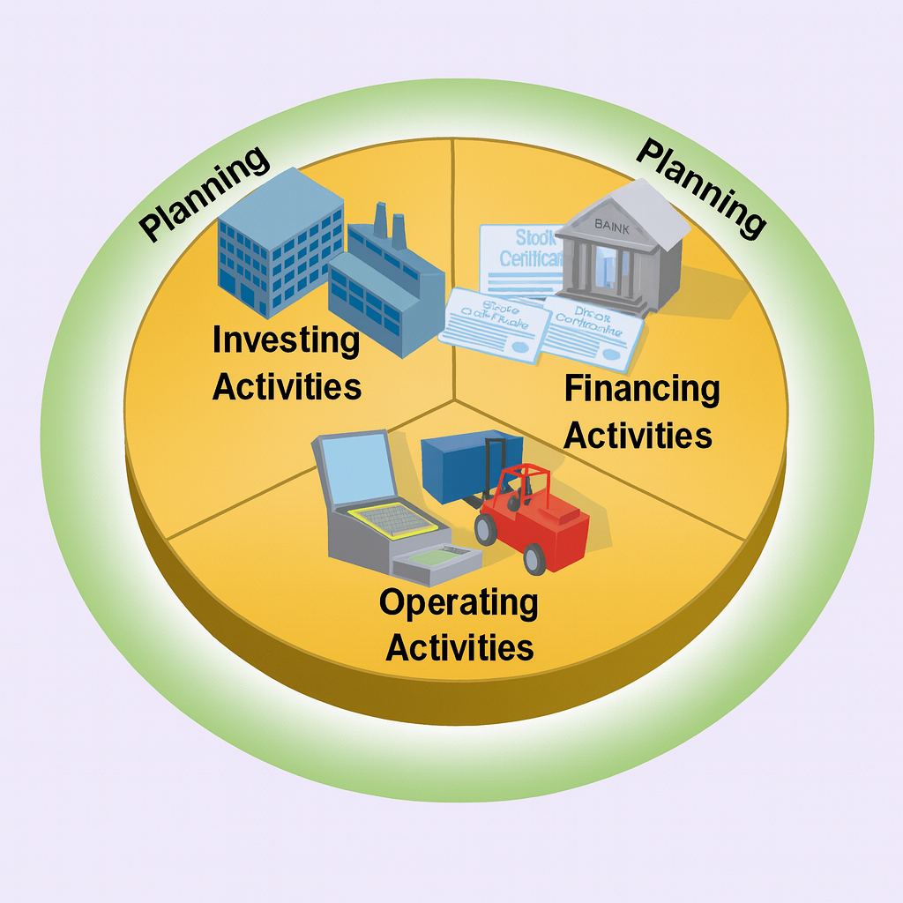
Business Activities
Financing Activities
  Obtaining funds from owners (Equity) or creditors (Debt).
Investing Activities
  Using funds to acquire resources (Assets – inventory or equipment).
Operating Activities
  Day-to-day processes producing goods/services.
Notes:
Business is a cycle.
A business organizes its efforts around three main types of activities: financing, investing, and operating. Together, these activities enable the business to achieve its primary objective — creating value and generating wealth.
First, you Finance (get money). Second, you Invest (buy machines/buildings). Third, you Operate (sell goods). This cycle repeats to generate wealth.

Slide 13
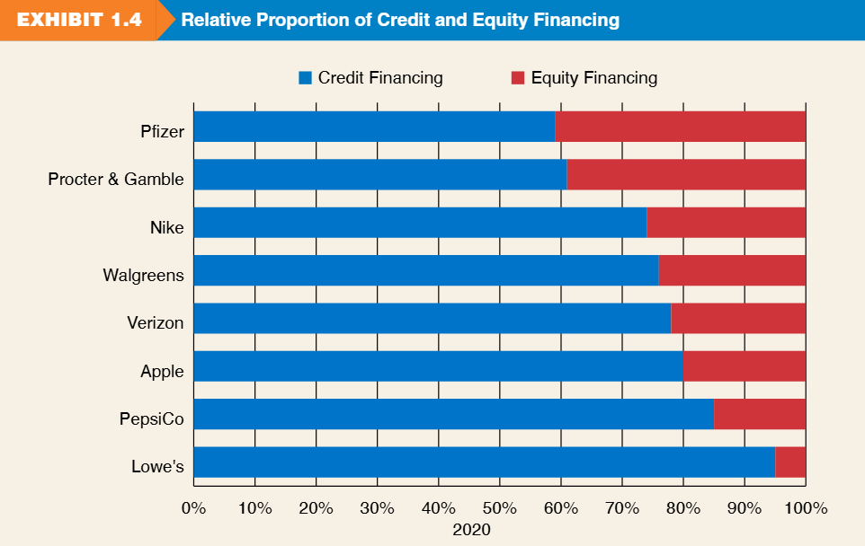
Financing Strategies
Firms use different mixes of credit and equity financing.
  Pfizer/Nike: Balanced mix.
  Lowe's: High reliance on credit financing (>90%).
  Alphabet/Facebook: High reliance on equity.
Notes:
Referencing Exhibit 1.4, we see that capital structure varies by industry. Some companies like Lowe's borrow heavily, while others like Apple rely more on equity.

Slide 14
3. The Four Financial Statements

Slide 15
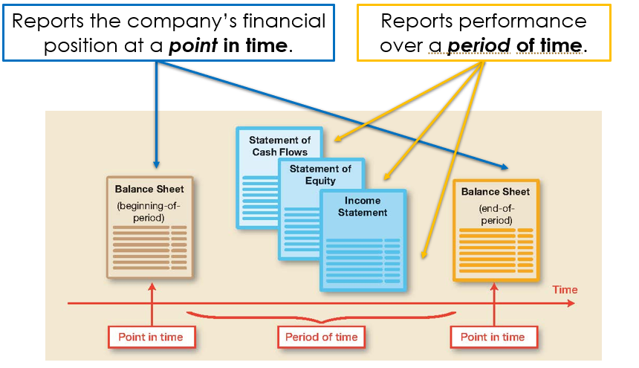
Four Financial Statements
Balance Sheet
  Investments (assets) and financing at a point in time.
Income Statement
  Results of operations over a period of time.
Statement of Stockholders' Equity
  Changes in owner financing.
Statement of Cash Flows
  Sources and uses of cash.
Notes:
These are the 'Big Four' documents. The Balance Sheet is a snapshot photo. The Income Statement is a video recording of performance over the year.

Slide 16
4. Deep Dive: The Four Core Statements

Slide 17
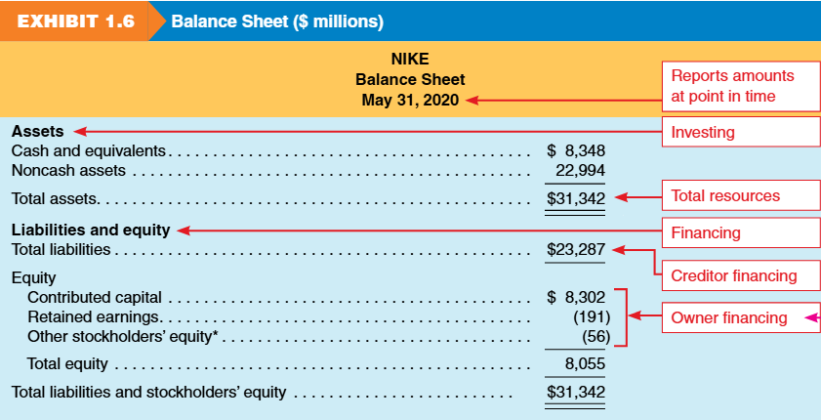
Balance Sheet
Balance sheet reports on a company’s financial position at a point in time.
It lists three elements: assets, liabilities, equity and sub-categories of each element.
It summarizes the results of investing and financing activities.
Notes:
This is the 'Position Statement.' It tells us what the company owns and owes on a specific day, like December 31st. It summarizes investing and financing activities.

Slide 18
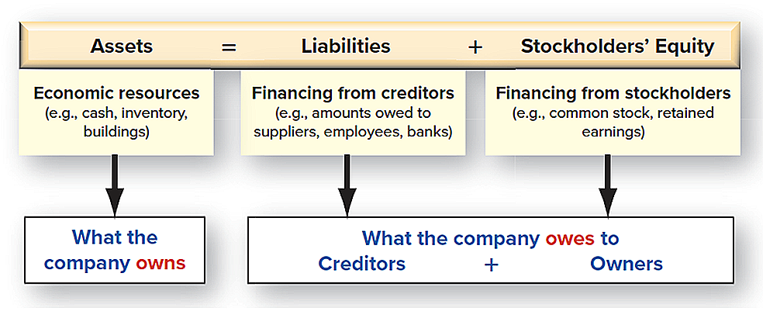
Balance Sheet
The Basic Accounting Equation for Balance Sheet
Notes:
This is the 'Position Statement.' It tells us what the company owns and owes on a specific day, like December 31st. It summarizes investing and financing activities.

Slide 19
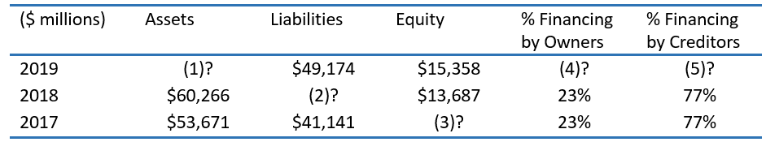
Review Problems 2 –the Accounting Equation
Determine the missing amounts for each year below for Delta Air Lines, Inc., including the percentage of financing provided by owners and creditors.
Answer:
$64,532
$46,579
$12,530
24%
76%
Notes:
This is the 'Position Statement.' It tells us what the company owns and owes on a specific day, like December 31st. It summarizes investing and financing activities.

Slide 20
Income Statement
The Income Statement reports
  the results of a company’s operating activities
  over a period of time
It has many different names
  Statement of Earnings
  Profit and Loss Statement (P&L)
  Statement of Operations
Income Statement Elements: Revenue and Expense
  Revenue = equity increase from selling goods/services
  Expense = cost to generate revenue.
  Net income = revenues – expenses.
Difference with balance sheet:
  Balance sheet = position at a point in time.
  Income statement = performance over a period of time.
Notes:
*Together, these filings are the main accounting information available to investors, analysts, and the public.

Slide 21
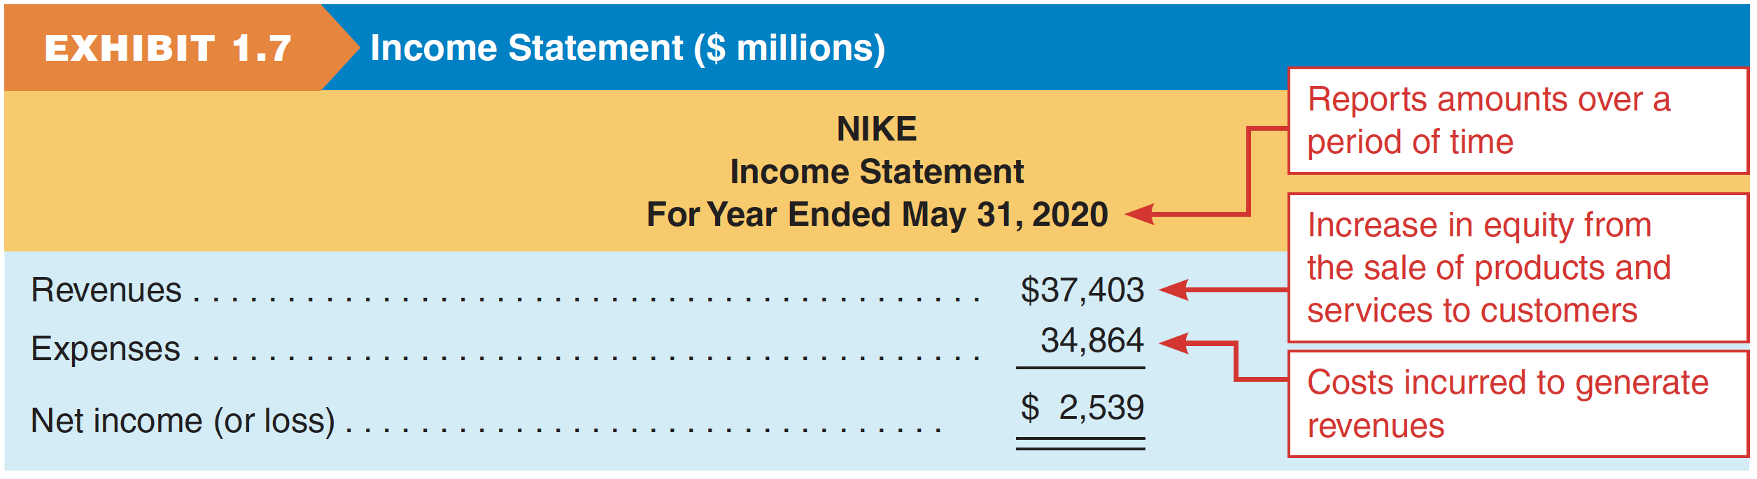
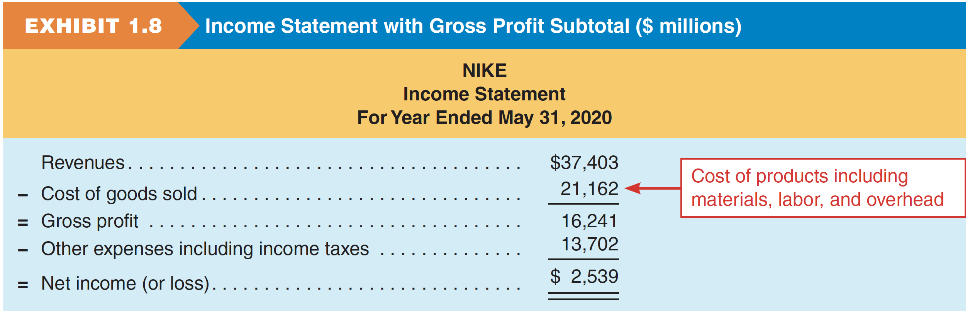
Income Statement
Nike’s profit is $2,539 million for its fiscal year ending 5/31/2020.
A more detailed format:
Notes:
Nike’s profit is $2,539 million for its fiscal year ending May 31, 2020.

Slide 22
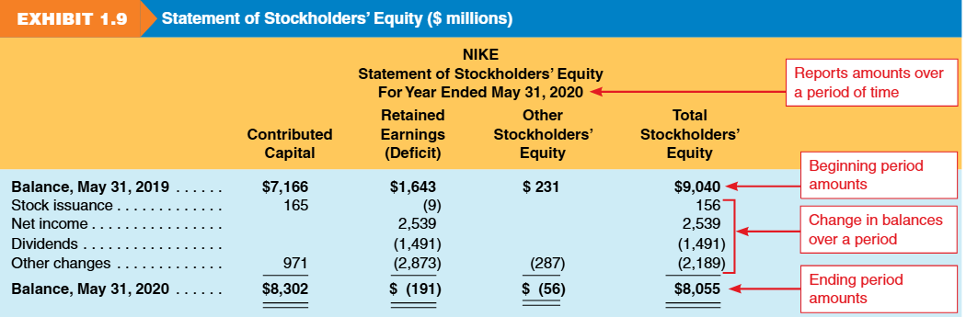
Statement of Stockholders' Equity
Shows changes in equity accounts over time
Main Components
  Contributed Capital
    Amounts received from issuing stock.
  Retained Earnings
    Cumulative net income minus dividends.
    Connects the income statement to the balance sheet.
  Other Equity Items
    Adjustments not included in net income.
Structure
  Presented in two dimensions:
    Vertical: changes over time
    Horizontal: equity categories
Notes:
This explains how the owners' stake changed during the year. Did the owners put more money in (Stock Issuance)? Did the company make profit (Net Income)? Did they pay cash out to owners (Dividends)?.
Nike’s paid out $1,491 million of its profit as dividends to shareholders during its fiscal year ending May 31, 2020.

Slide 23
Statement of Cash Flows
The statement of cash flows reports net cash flows from operating, investing, and financing activities over a period of time.
Operating cash flow ≠ Net income due to timing differences in recognition vs cash collection/payment.
Both cash flow and net income are essential for decisions, reflecting different aspects of firm performance.
Notes:
Profit is not the same as Cash. You can make a sale on credit (Revenue) but not get the cash for 30 days. This statement tracks the actual movement of hard cash.

Slide 24
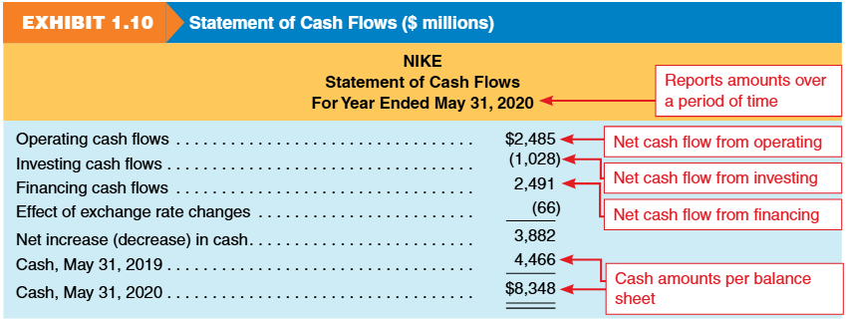
Statement of Cash Flows
Notes:
Profit is not the same as Cash. You can make a sale on credit (Revenue) but not get the cash for 30 days. This statement tracks the actual movement of hard cash.

Slide 25
Articulation of Financial Statements
How the statements connect (the Flow):
  Income Statement yields Net Income.
  Net Income flows into Statement of Equity (Retained Earnings).
  Ending Equity flows into the Balance Sheet.
  Change in Cash (Cash Flow Stmt) matches Cash on Balance Sheet.
Notes:
These documents talk to each other. You cannot finish the Balance Sheet until you know the Ending Equity. You cannot know Equity until you know Net Income from the Income Statement.

Slide 26
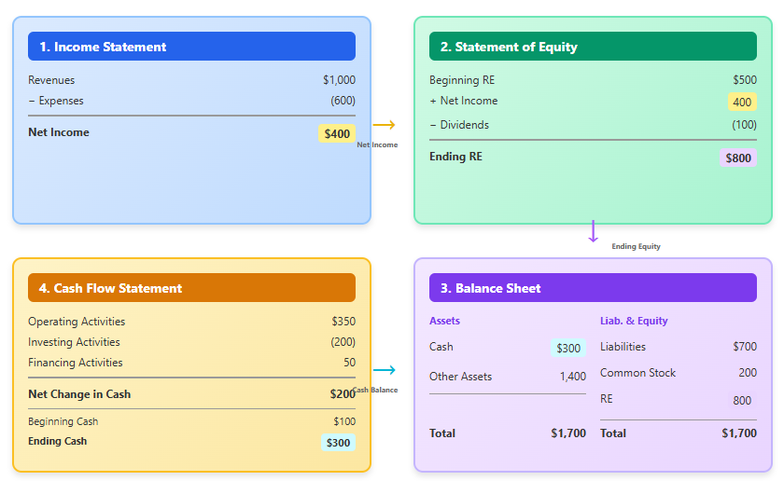
Articulation of Financial Statements
Notes:
These documents talk to each other. You cannot finish the Balance Sheet until you know the Ending Equity. You cannot know Equity until you know Net Income from the Income Statement.

Slide 27
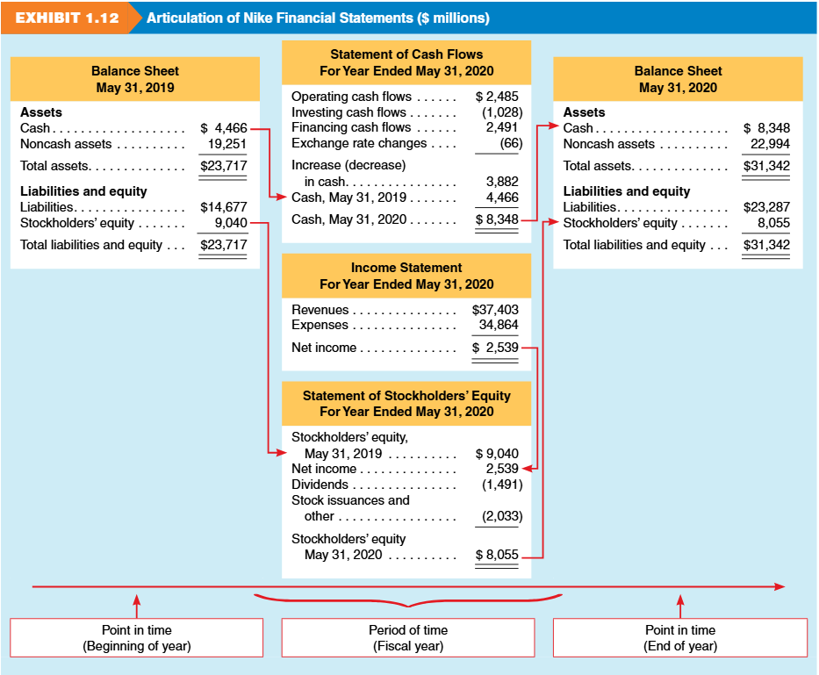
Articulation of Nike Financial Statements
(10)
(2)
(3)
(4)
(11)
(1)
(5)
(6)
(7)
(9)
Notes:
These documents talk to each other. You cannot finish the Balance Sheet until you know the Ending Equity. You cannot know Equity until you know Net Income from the Income Statement.

Slide 28
Information Beyond Financial Statements
Management Discussion and Analysis (MD&A)
Independent auditor report
Financial statement footnotes
Regulatory filings, including proxy statements and other SEC filings
Environmental, Social, and Governance (ESG) reporting
Nike’s 10-K Report (2024):
https://investors.nike.com/investors/news-events-and-reports/default.aspx
Notes:
These documents talk to each other. You cannot finish the Balance Sheet until you know the Ending Equity. You cannot know Equity until you know Net Income from the Income Statement.

Slide 29
Review Problem 3: Samsung Electronics
The following financial information is from Samsung Electronics, a competitor of Apple, for December 31, 2022 (in billions Korean won).
Required: Prepare an income statement and statement of cash flows for Samsung Electronics for the year ended December 31, 2022. Prepare Samsung Electronics’ balance sheet as of December 31, 2022.
Item | Amount (₩ billions)
Short-term liabilities | 78,345
Cash flows used in financing | (19,928)
Revenues | 302,231
Stockholders' equity | 354,750
Cash flows from operations | 62,181
SG&A expenses | 68,813
Long-term assets | 229,954
Interest income | 3,064
Cost of goods sold | 190,042
Cash, beginning-year | 39,031
Provision for income taxes | (9,214)
Short-term assets | 218,471
Long-term liabilities | 15,330
Cash, ending year | 49,681
Cash flows used in investing | (31,603)
Notes:
In this exercise, we take raw data and organize it. Note that Assets equal Liabilities plus Equity (448,425). This confirms our Balance Sheet is balanced.

Slide 30
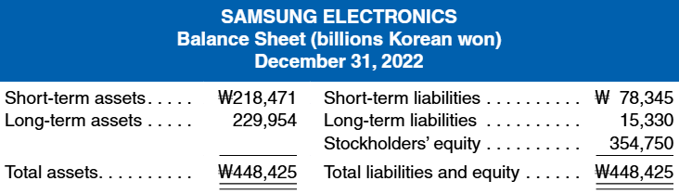
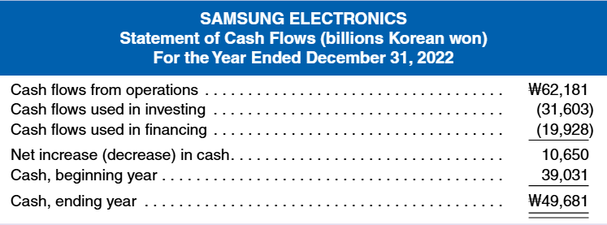
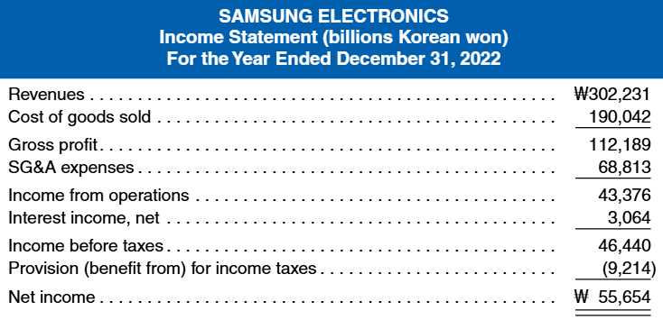
Review Problem 3: Samsung Electronics - Solution
Notes:
In this exercise, we take raw data and organize it. Note that Assets equal Liabilities plus Equity (448,425). This confirms our Balance Sheet is balanced.

Slide 31
5. Financial Reporting Environment

Slide 32
Generally Accepted Accounting Principles (GAAP)
Standards and accepted practices designed to guide the preparation of financial statements
Based on underlying principles (GAAP)
Allows considerable discretion in preparation
Enables external users to rely on audited financial statements
These financial statements were prepared in accordance with GAAP and were audited!

Slide 33
Regulation and Oversight – the SEC
Securities Act of 1934
created
Securities & Exchange Commission (SEC)
The SEC’s Authority
  Regulates the issuance and trading of securities in the U.S.
Who must report to the SEC?
  Companies with more than $10 million of assets and whose securities are held by more than 500 owners must file annual and other periodic reports.

Slide 34
Regulation and Oversight - FASB
Financial Accounting Standards Board
Currently establishes accounting standards in the U.S.
Developed a Conceptual Framework to serve as a guide for accounting issues not covered by standards
Referred to as FASB by the accounting profession

Slide 35
Management and Auditors
Management
Prepares financial statements.
Takes responsibility for what is disclosed in the financial statements.
Independent Auditors
“Audit” financial statements as assurance of accuracy and completeness.
Provide an 'opinion' (assurance) on accuracy.
Financial statements of publicly traded companies must be audited by an independent audit firm.
An audit opinion is not a guarantee.
Notes:
It is a common misconception that auditors are responsible for the numbers. Management is responsible. Auditors just check the work to provide reasonable assurance.
“Audit” financial statements
As assurance of accuracy and completeness, financial statements of publicly traded companies must be audited by an independent audit firm.

Slide 36

Regulation and Oversight - Sox
Sarbanes-Oxley Act (SOX) of 2002
Created by Congress to address concerns about unreliable financial reporting.
Aimed to restore investor confidence in corporate financial statements.
Established the PCAOB to:
  Set and approve auditing standards.
  Monitor audit quality and compliance with GAAP.
Notes:
Sarbanes-Oxley Act of 2002
Referred to as SOX by the accounting profession.
Developed by Congress due to concerns over the quality of corporate financial reporting.
Goal was to increase the level of confidence that external users have in financial statements.
SOX then established the Public Accounting Oversight Board (PCAOB) to approve auditing standards and to monitor the quality of financial statements and audits (GAAP).

Slide 37
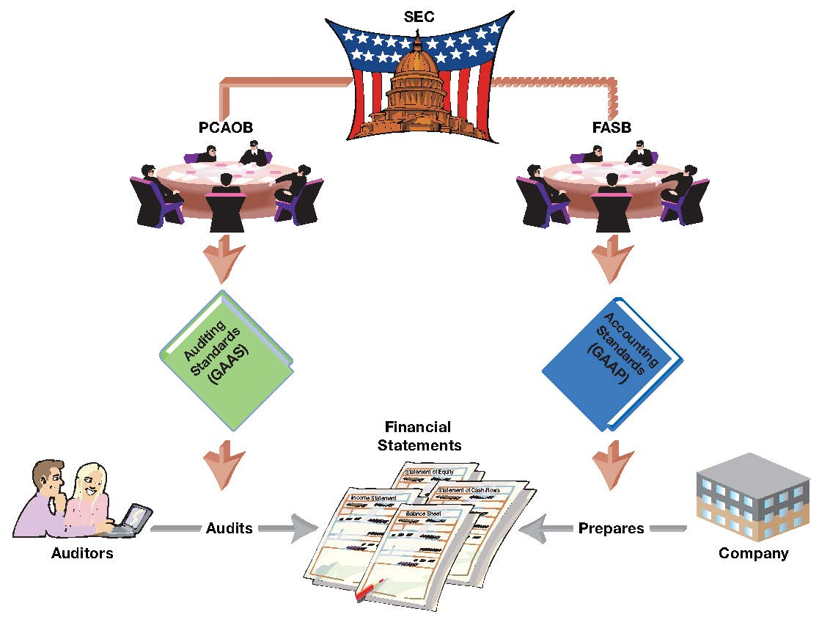
Regulation and Oversight - Sox
Notes:
Sarbanes-Oxley Act of 2002
Referred to as SOX by the accounting profession.
Developed by Congress due to concerns over the quality of corporate financial reporting.
Goal was to increase the level of confidence that external users have in financial statements.
SOX then established the Public Accounting Oversight Board (PCAOB) to approve auditing standards and to monitor the quality of financial statements and audits (GAAP).

Slide 38
Global Perspective (GAAP vs. IFRS)
Why Global Standards Exist
  Global capital markets need comparable financial information.
  Reduces costs for companies and improves transparency for investors.
Key Standard Setters
  FASB – Issues U.S. GAAP.
  IASB – Issues IFRS, used by 100+ countries (EU, UK, Canada, Japan).
GAAP vs. IFRS
  Both produce the same core statements (BS, IS, CF, Equity).
  Differ in detailed rules and treatments, but share similar concepts.
Adoption and Use
  100+ countries mandate IFRS; all EU countries use it.
  SEC allows foreign firms to file IFRS without U.S. GAAP reconciliation.
Comparability & Convergence
  Past joint projects (leases, revenue, financial instruments).
  No active convergence now, but comparability remains a priority.
Notes:
Business is global. While the US uses GAAP, most of the world uses IFRS. The goal is for an investor in New York to easily compare a company in London with one in Tokyo.

Slide 39
Review Problem 4: Regulatory Roles
Match each of the following terms with the most appropriate explanation of its relationship to financial reporting.
Terms: (a) Auditor, (b) FASB, (c) GAAP, (d) Internal controls, (e) Management, (f) PCAOB, (g) SEC
1. _____ Set of authoritative standards and accepted practices that guide the preparation of financial statements in the U.S.
2. _____ Organization that has the ultimate authority over financial reporting.
3. _____ Currently codifies new accounting standards that guide financial reporting.
4. _____ Approves auditing standards and monitors audits of public companies that are required to report annual results.
5. _____ Takes responsibility for the accuracy and completeness of information disclosed in the financial statements.
6. _____ Provides an opinion on the fair presentation of a company’s financial reporting.
7. _____ Helps ensure the accuracy of a company’s financial reporting through a system of internal monitoring procedures and rules.
Notes:
A quick check on the ecosystem. FASB writes the rules. SEC enforces them. PCAOB watches the auditors. Management owns the data.

Slide 40
Review Problem 4: Regulatory Roles
Match each of the following terms with the most appropriate explanation of its relationship to financial reporting.
Terms: (a) Auditor, (b) FASB, (c) GAAP, (d) Internal controls, (e) Management, (f) PCAOB, (g) SEC
1. GAAP: Set of authoritative standards and accepted practices that guide the preparation of financial statements in the U.S.
2. SEC : Organization that has the ultimate authority over financial reporting.
3. FASB : Currently codifies new accounting standards that guide financial reporting.
4. PCAOB: Approves auditing standards and monitors audits of public companies that are required to report annual results.
5. MANAGEMENT : Takes responsibility for the accuracy and completeness of information disclosed in the financial statements.
6. AUDITOR : Provides an opinion on the fair presentation of a company’s financial reporting.
7. INTERNAL CONTROLS: Helps ensure the accuracy of a company’s financial reporting through a system of internal monitoring procedures and rules.
Notes:
A quick check on the ecosystem. FASB writes the rules. SEC enforces them. PCAOB watches the auditors. Management owns the data.

Slide 41
6. Analyzing Financial Statements

Slide 42
Analyzing Financial Statements
Why Analysis and Interpretation Matters
  Raw numbers (net income, liabilities, etc.) lack meaning without context.
  Financial statements show performance but require analysis to understand.
Role of Ratios
  Help compare companies, regardless of size.
  Reveal trends, profitability, and potential risks.
Notes:
Is a $1 million profit good? For a small bakery, yes. For Apple, no. Ratios turn absolute numbers into comparable percentages to provide this context.

Slide 43
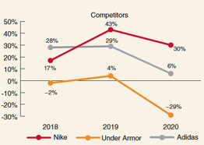
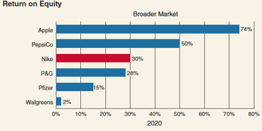
Profitability Analysis (ROE)
Return on Equity (ROE)
  Measures a firm’s ability to generate returns for stockholders.
Formula
  ROE = Net Income / Average Stockholders' Equity.
Nike Example
  ROE 30-42%. (Guidance: >10 % is strong).
Takeaways: Nike ROE
  Strong Performance
    ROE: 42% (2019) and ~30% (2020).
    Well above key competitors (Adidas, Under Armor).
  What It Means
    High ROE → strong shareholder returns.
    Sustained leadership depends on continued product innovation.
Notes:
ROE tells shareholders how well their money is being used. Nike's exceptionally high ROE indicates it is very efficient at generating profit from shareholder capital.

Slide 44
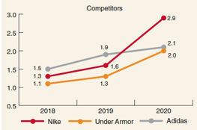
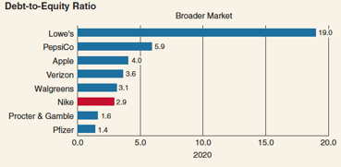
Credit Risk Analysis (D/E Ratio)
Purpose
  Assess risk when investing in or lending to a company.
  Long-term solvency is key measured by Debt-to-Equity (D/E) ratio.
Analysis Focus
  Objective :Evaluate ability to meet interest and principal payments.
  Tool:
    D/E = Total Liabilities ÷ Total Equity
    Nike: 1.30 (2018) → 1.62 (2019) → 2.89 (2020)
Interpretation
  Higher D/E = greater reliance on debt and higher bankruptcy risk.
  Nike’s rising D/E shows liabilities growing faster than equity.
Takeaways
  Nike’s 2020 D/E exceeded competitors.
  Its high ROE is partly driven by increased debt financing.
Notes:
This measures risk. Nike took on more debt relative to equity over these three years. While this increases risk, it can also boost ROE if the borrowed money is invested wisely.

Slide 45
Review Problem 5: Adidas vs. Nike
Adidas, a major competitor of Nike, markets athletic shoes and apparel under the Adidas and Reebok brands. It also sells Solomon ski equipment and TaylorMade golf equipment. The following information is from Adidas’s 2019 financial statements (Adidas’s financial statements are reported in Euros, the currency of the European Union):
Required :
a. Calculate the 2019 return on equity (ROE) ratio for Adidas.
b. Calculate the 2019 debt-to-equity ratio for Adidas.
c. Compare the profitability and risk of Adidas to that of Nike. Note: In your analysis, compare FY 2020 statements of Nike (12 months ended May 31, 2020) to 2019 statements of Adidas (12 months ended December 31, 2019).
(millions) | Adidas
Net income (loss) (2019) | € 1,977
Stockholders’ equity (2019 year-end) | 7,058
Stockholders’ equity (2018 year-end) | 6,364
Total liabilities (2019 year-end) | 13,622
Notes:
Here we see the power of ratios. We can compare Adidas (Euros) to Nike (Dollars) directly. They have similar profitability, but Nike is carrying significantly more debt/risk.

Slide 46
Review Problem 5: Solutions
ROE = €1,977 / [(€6,364 + €7,058) / 2] = 0.295 or 29.5%
Debt-to-equity = €13,622 / €7,058 = 1.93
One additional benefit to using ratios to analyze financial information is that ratios can be computed for amounts denominated in any currency. Thus, we can compare Adidas and Nike without translating euros into dollars. Adidas’s ROE of 29.5% is almost identical to Nike’s of 29.7%. This means that both companies earned a very similar return for their stockholders in 2019.
Adidas’s debt-to-equity ratio is 1.93 compared to Nike’s 2.89. This means that Nike relies more on debt financing, but again the companies are quite similar. A similar debt-to-equity ratio indicates a similar level of risk associated with an investment in either company.
Notes:
Here we see the power of ratios. We can compare Adidas (Euros) to Nike (Dollars) directly. They have similar profitability, but Nike is carrying significantly more debt/risk.

