Slide 1
Chapter 2: Constructing Financial Statements

Slide 2
Table of Contents
1. Balance Sheet – Reporting Financial Condition
  Assets: What they are and when to record
  Categories of Assets
  Liabilities and Equity
  Market Value vs. Book Value
2. Income Statement – Reporting Financial Performance
3. Single-Step vs. Multi-Step Income Statement
4. Accounting Cycle – Transactions to Financial Statements
5. How do Companies Record Transactions?
Notes:
We will move through six sections, starting with why we need accounting information, moving through the mechanics of the statements, and finishing with how to analyze those statements using ratios like ROE.

Slide 3
1. Balance Sheet – Reporting Financial Condition

Slide 4
Balance Sheet – Reporting Financial Condition
Three Main Sections:
ASSETS
LIABILITIES
EQUITY
Purpose:
Shows the resources a company controls (assets) and the claims on those resources by creditors (liabilities) and owners (equity).
Timing:
Reports financial position at a point in time (a snapshot on a specific date).
Permanent Accounts:
Balance sheet accounts carry forward from period to period—ending balance becomes next period's beginning balance.
Notes:
Accounting is more than just math; it is a system of communication. The key distinction is the audience. Financial accounting targets outside decision-makers like banks and shareholders, whereas Managerial accounting is for the internal team running the business.

Slide 5
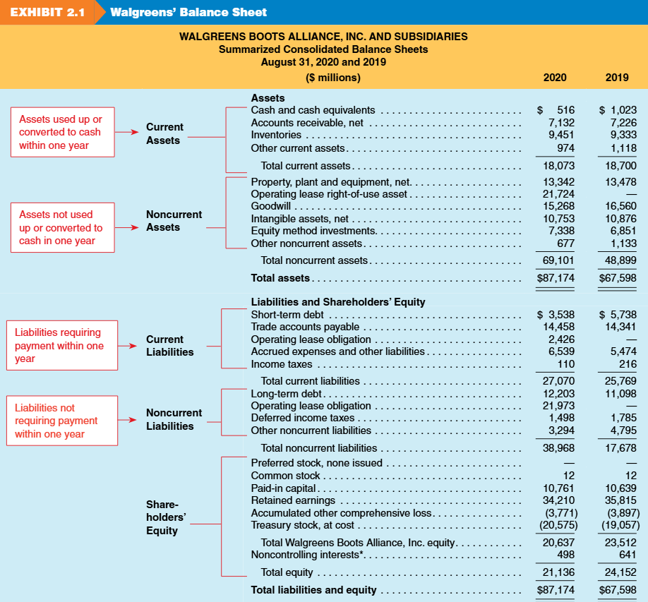

Slide 6
Assets – What They Are and When to Record
Timing of Benefit in Asset Recognition
Companies incur costs to acquire resources.
Every cost provides either immediate benefit or future benefit.
Immediate Benefit → Expense NOW
Hits the income statement immediately
Future Benefit → CAPITALIZE
Record as an asset on the balance sheet
As Benefits Are Used:
Inventory (asset) → Cost of Goods Sold (expense)
Equipment (asset) → Depreciation (expense)

Slide 7
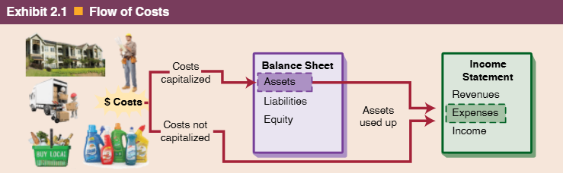
Assets – What They Are and When to Record

Slide 8

What is an Asset?
Definition
A resource the company owns or controls that is expected to provide future economic benefits.
Examples of Assets
Not Assets
✓ Cash and investments
✗ Advertising costs
✓ Accounts receivable
✗ Most salaries
✓ Inventory
✗ Utilities consumed
✓ Equipment and buildings
✗ Benefits not measurable
✓ Prepaid expenses
✗ Past expenses
Coca-Cola brand ($46B value): Asset? Not unless acquired through purchase

Slide 9
When Do We Record (Capitalize) an Asset?
Recognition Criteria
Control is Obtained
At acquisition or from a past transaction (buying, producing, exchanging, or assuming an obligation)
Benefits Are Probable and Measurable
Record at historical cost (cost principle)
What Can "Future Benefits" Look Like?
Cash inflows from selling the asset or products
Other assets received (e.g., A/R from credit sales)
Reduction of liabilities (using asset to settle debt)
Future services already paid for (prepaid insurance)
When to Expense Immediately
When future benefits cannot be measured reliably or are not probable
The cost goes straight to the income statement in the period incurred

Slide 10
Asset or Expense?
Decision Framework
CAPITALIZE
EXPENSE
Future benefits probable and measurable
Immediate benefit or not measurable

Slide 11
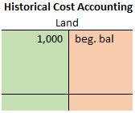
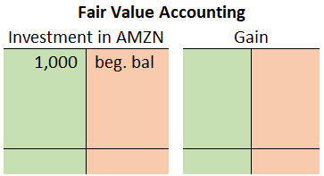
How Do We Measure Assets on the Bal. Sheet?
At the Time of Acquisition
Initially all assets are recorded at cost
In Subsequent Periods
Historical Cost Method
Reported at purchase cost
Examples: Land, Inventory, Equipment
Reliable, but may understate value
1,000
end. bal
Fair Value Method
Reported at current market value
Example: Marketable securities
Objective when market prices exist
200
value ↑
200
1,200
end. bal
200
Notes:
Historical cost method
Some assets remain at historical cost on the balance sheet regardless of the current fair value
Example: Land, Inventory, and Equipment
Historical cost is reliable but often significantly undervalued
Fair Value Method
Some assets are reported at current fair value
Example: Marketable securities
Fair value is reliable and objective because of real-time stock quotes.

Slide 12
Review Problems 1 – Assets?
For each scenario, decide whether it qualifies as an asset.
1.
A tech firm spent $12 million on early-stage development of a wearable device, but the product concept is not yet proven to be commercially viable.
Answer: No
Early-stage development is treated as research. Future benefit is uncertain, and no measurable asset is controlled.
2.
A company signed a $4 million purchase order and paid a $400,000 deposit to the vendor.
Answer: Partially (Only $400K)
The $4M purchase order is executory and not yet recognized. The $400K deposit is an asset (prepaid/deferred cost) since cash was paid and future benefit is expected.
Notes:
Historical cost method
Some assets remain at historical cost on the balance sheet regardless of the current fair value
Example: Land, Inventory, and Equipment
Historical cost is reliable but often significantly undervalued
Fair Value Method
Some assets are reported at current fair value
Example: Marketable securities
Fair value is reliable and objective because of real-time stock quotes.

Slide 13
Review Problems 1 – Assets? (continued)
For each scenario, decide whether it qualifies as an asset.
3.
Company launched $3M promotional campaign for new product line.
Answer: No
Advertising costs expensed. Difficult to measure future benefit.
4.
A business acquired another company by issuing $3 million of its own preferred shares.
Answer: Yes
A business combination is a completed transaction. The acquired assets are recognized; equity issuance is simply the payment method.
5.
Healthcare firm reimbursed $1M in tuition for employees.
No (expensed)
Notes:
Historical cost method
Some assets remain at historical cost on the balance sheet regardless of the current fair value
Example: Land, Inventory, and Equipment
Historical cost is reliable but often significantly undervalued
Fair Value Method
Some assets are reported at current fair value
Example: Marketable securities
Fair value is reliable and objective because of real-time stock quotes.

Slide 14
Categories of Assets
Current Assets
Assets expected to be used, sold, or converted to cash within one year or operating cycle (whichever is longer)
Noncurrent Assets
Assets providing economic benefits beyond one year,
not intended for quick conversion to cash

Slide 15
Liabilities and Equity
Liabilities and Equity
Represent source of capital to the company
Used to finance the acquisition of assets
What is a liability
Probable future economic sacrifice from a current or past event
Either future cash payments or obligation to deliver goods/services later
Three conditions for recognizing a liability
Future sacrifice is probable.
Amount is known or reasonably estimated.
Transaction/event causing obligation has occurred
Executory contract:
When conditions (1) and (2) are met but (3) hasn’t occurred.
No liability is reported (but should be disclosed if material).
Example: purchase order for materials.

Slide 16
Stockholder's Equity
Residual interest of shareholders
Represents shareholder-provided capital.
Stockholders have claim on assets after creditors are paid.
Key Components
Common stock – capital from issuing shares; each share = ownership unit.
Preferred Stock – capital from issuing shares that have priority over common stock in dividends and liquidation, but usually no voting rights.
Additional paid-in capital – amounts received above par/stated value of stock.
Treasury stock – company’s own shares repurchased; reduces contributed capital.
Contributed Capital
Earned Capital
Retained earnings – accumulated profits not paid as dividends.
Accumulated other comprehensive income (AOCI) – equity changes not reported in net income (e.g., foreign currency, pension adjustments).

Slide 17
Retained Earnings ( Stockholder's Equity )
Retained Earnings
Tracks changes in retained earnings from year to year.
Connects income statement (net income) to balance sheet (equity).
Retained Earnings Equation
Retained earnings (Beginning, Jan 1 2028) $200
+ Net income (or – Net loss) + 50
Dividends - 10
= Retained earnings (Ending, Dec 31 2028) $240

Slide 18
Review Problem 2 – R.E. Balance Calculation
Sunnyvale Services, Inc. reported retained earnings of $85,000 at the beginning of 2028. During the year, the company earned revenues of $150,000 and incurred expenses of $110,000. In December, the company declared and paid cash dividends of $12,000 to its shareholders. What is the ending balance of retained earnings?
Problem
Solutions
Description | Amount
Beginning Retained Earnings | $85,000
+ Net Income | 40,000
− Dividends | (12,000)
= Ending Retained Earnings | $113,000

Slide 19
Book Value vs. Market Value
Key Distinction
Book value reflects historical accounting (GAAP-based stockholders' equity), while market value reflects investor expectations about future performance.
Book Value
Market Value (Market Cap)
Definition: The "value" of a company determined by Generally Accepted Accounting Principles (GAAP); also called book value of equity or stockholders' equity.
Example: Apple's book value of equity (Sept 24, 2022) = $50,672 million
Calculation: Number of outstanding common shares × Stock price
Example: Apple's market cap (Sept 24, 2022) = $2.4 trillion ($150.43 per share × 15.9 billion shares)
Key Insight: Typically, a company's market value is much larger than its book value—Apple's market value was ~47× its book value!

Slide 20
Why Market and Book Values Differ
Core Principle
GAAP does not capture future performance,
Market values attempt to predict it.
Reasons for the Difference
Market-to-Book Ratio : S&P 500 Median
Unrecorded Assets: Not all assets are recorded on the balance sheet (e.g., internally generated goodwill, brand value, human capital)
Historical Cost: Many assets are reported at historical cost, which does not reflect their current appreciated market value
2022: 3.38
2025: 2.91
Interpretation: Market-to-book ratio > 1 typically reflects intangible value (e.g. innovation, leadership) and future growth.
Key Insight: Typically, a company's market value is much larger than its book value—Apple's market value was ~47× its book value!

Slide 21
Review Problem 3 – Classifying B/S Accounts
Assume Schaefer’s Pharmacy, Inc., has the following detailed accounts as part of its accounting system. Enter the letter of the balance sheet category A through E in the space next to the balance sheet items numbered 1 through 20. Enter an X in space if the item is not reported on the balance sheet.
A. Current assets B. Noncurrent assets C. Current liabilities
D. Noncurrent liabilities E. Equity X. Item not reported on balance sheet
Problem
Account | Category | Account | Category
Accounts receivable | A | Treasury stock | E
Land | B | Accounts payable | C
Retained earnings | E | Prepaid insurance | A
Common stock | E | Operating lease right-of-use asset | B
Repairs expense | X | Investments | B
For more problems, please see the note

Slide 22
2. Income Statement– Reporting Financial Performance

Slide 23
Income Statement Components
Income statement reports the results of operations for a business for a given time period.
Revenues
increases in net assets from delivering goods/services.
Expenses
decreases in net assets from revenue-generating activities (COGS, wages, advertising, depreciation, interest, taxes).
Net Income
when revenues exceed expenses.
Net Loss
when expenses exceed revenues.

Slide 24
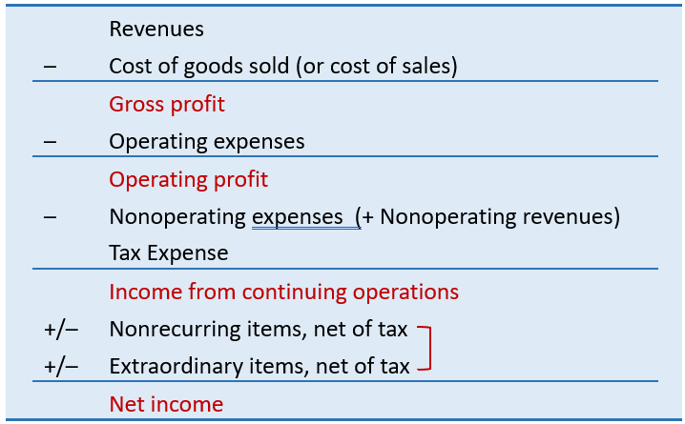
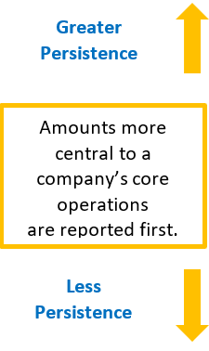
General Structure of an Income Statement
Tax expense applies to Income from continuing operations
Transitory items - not expected to recur; reported ‘net of tax’

Slide 25
Classification of Expenses – Why?
Operating Expenses
Usual and necessary costs to support main activities.
Include: COGS, wages, depreciation, amortization, R&D
Nonoperating Revenues and Expenses
Relate to financing and investing activities
Examples : interest revenue, interest expense
Separated from operating activities for better performance insights.
Key Insights
Separating income types helps forecast future company performance
Nonrecurring items unlikely to persist → less relevant for predictions.

Slide 26
Transitory Items and Gross Profit Margin
Discontinued Operations
Gains or losses from business segments being sold or sold in current period
Extraordinary Items
Gains or losses from events that are both unusual and infrequent
Gross Profit Margin = Gross Profit ÷ Sales
Reflects selling price of products vs. cost to make or buy them.
Example: Sell for $10, cost $6 → gross profit margin = 40%.
High/increasing margin
Less competition, product strength
Low/declining margin
Intense competition, rising costs

Slide 27
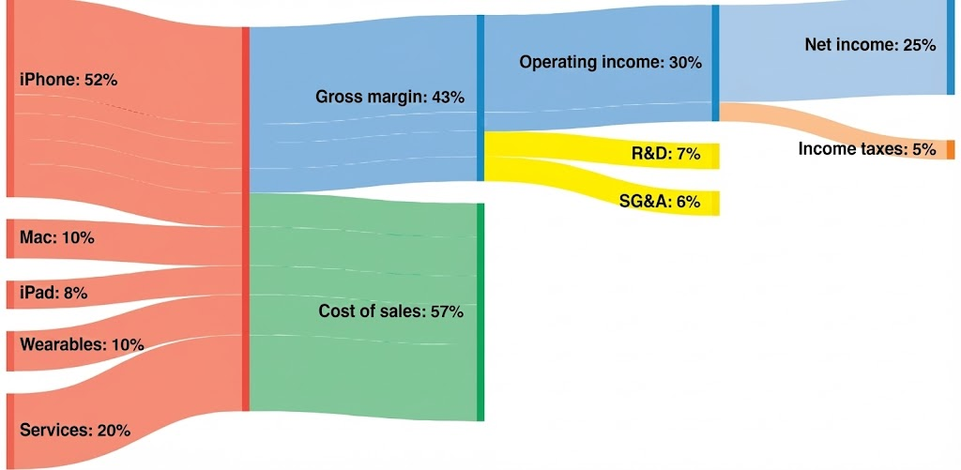
Visualizing Apple, Inc (2022) Income Statement

Slide 28
3. Single-Step vs. Multiple-Step Income Statement

Slide 29
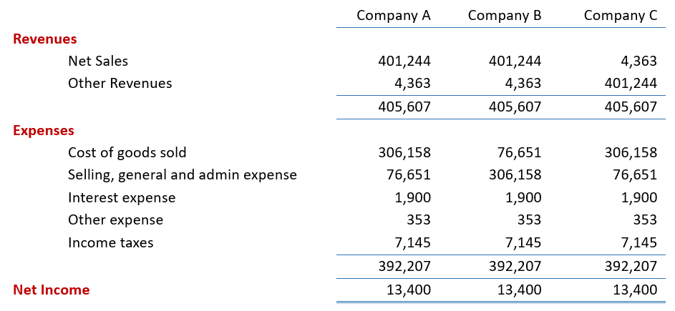
Single-Step Income Statement

Slide 30
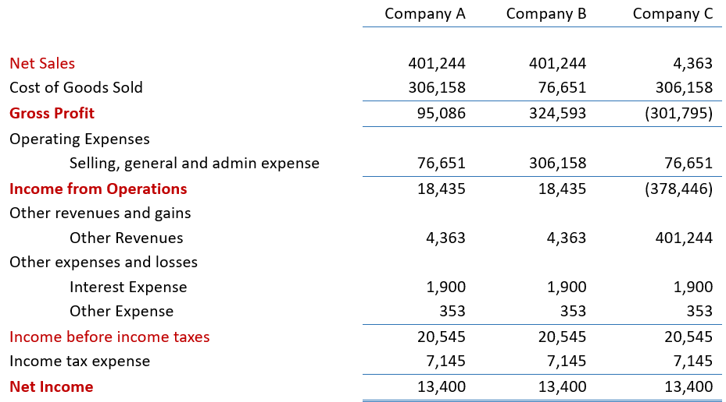
Multiple-Step Income Statement

Slide 31
Concept Quiz 1
  1. Net income is $15,000, operating expenses are $20,000, and net sales total $75,000. What is gross profit?
  a. $60,000 b. $40,000 c. $35,000 d. $15,000
  2. Gross profit is $50,000, operating expenses are $15,000, and net sales total $75,000. What is net income?
  a. $10,000 b. $25,000 c. $35,000 d. $80,000
  3. Net income is $15,000, operating expenses are $20,000 and net sales total $75,000. What is cost of goods sold?
  a. $60,000 b. $40,000 c. $35,000 d. $15,000
Problem
Answers: 1 C, 2 C, 3 B

Slide 32
4. Accounting Cycle – Transactions to F/S

Slide 33
Accounting Transactions
What Gets Recorded?
Among business events, only transactions are recorded in the company's accounting information system
What Are Transactions?
Not all activities (or events) represent transactions.
Transactions are events that cause a change in the company’s assets, liabilities, or owners’ equity.
Recorded (i.e., Transactions)
Not Recorded (Not a transaction)
Equipment purchased
Cash investment made
Owner withdraws cash
Employee terminated
Events without financial impact

Slide 34
Concept Quiz 2
  Which of the following events is not recorded in the accounting records? (i.e. which events do not affect the assets, liabilities or equity?)
    An employee is terminated.
    Equipment is purchased on account.
    A cash investment is made into the business.
    The owner withdraws cash for personal use.
Problem
Ans: a. Employee termination does not affect Assets, Liabilities, Equity, Revenue, Expenses.

Slide 35
5. How Do Companies Record Transactions?

Slide 36
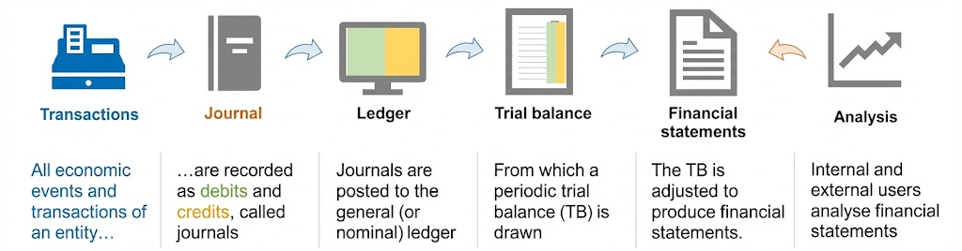
A Summary of the Accounting Process
The Process Flow
Record transactions in the Journal (book of original entry)
Post information from journal to the Ledger
Prepare financial statements based on ledger balances
Analyze the financial statements

Slide 37
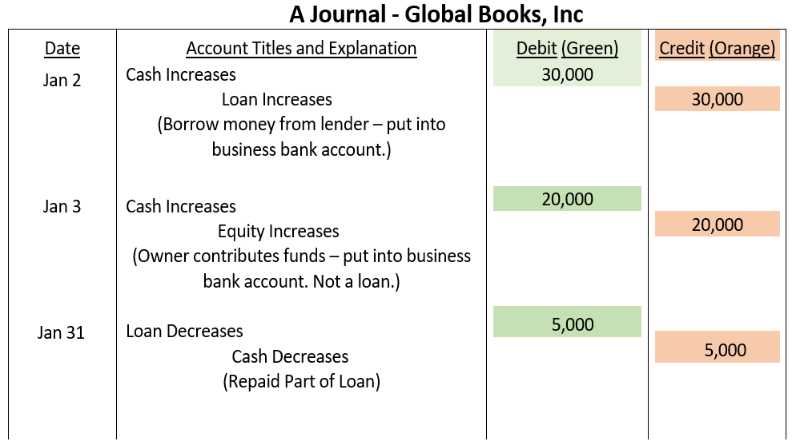
The Journal
What is a Journal?
The book of original entry
Records all transactions in chronological order
Shows the complete story of each transaction
Key Information in Each Enry
1) Date of transaction
2) Accounts affected
3) Amounts (debits and credits)
4) Brief Explanations

Slide 38
Ledger Accounts & T-Accounts
What is a Ledger Account (or Account)
The book of original entry
A record that summarizes all transactions related to a specific item over time.
Think of it as a “running total” for each category in the financial statements.
T-Account Structure
Each Account Tracks
Visual representation with three parts:
Title (account name)
Left side = Debit side
Right side = Credit side
increases/decreases, current balance for one specific asset, liability, equity, revenue or expense.
T-accounts are often used
Note: Ledger account is often called “Account”.
General ledger is often called “Ledger”.

Slide 39
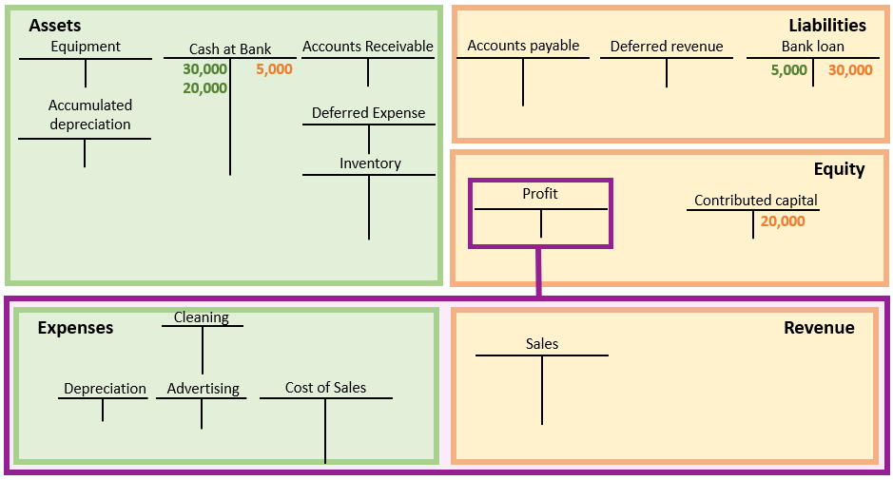
The Posting Process
What is posting ?
The process of transferring transaction information from the Journal to the appropriate Accounts (or Ledger Accounts) in the General Ledger
An example of general ledger
A general ledger is a collection of accounts (e.g., cash, equipment, sales)
Each account is displayed in a T-account format
Increases and decreases are recorded on the left or right side of each account
Journal transactions are posted to the corresponding ledger accounts

Slide 40
Trial Balance – Optional Step
What is a Trial Balance?
A list of all ledger accounts with their debit or credit balances at a specific point in time.
Purpose
Verify that total debits = total credits
Check double-entry accounting integrity
Optional but useful verification step

Slide 41
Financial Statement Preparation
The Final Step
From the trial balance, each account (or group of accounts) is summarized and disclosed within the correct part of the financial statements
Income Statement
Balance Sheet
Revenues & Expenses
Assets, Liabilities & Equity
Transactions → Journal → Ledger → (Trial Balance ) → Financial Statements

Slide 42
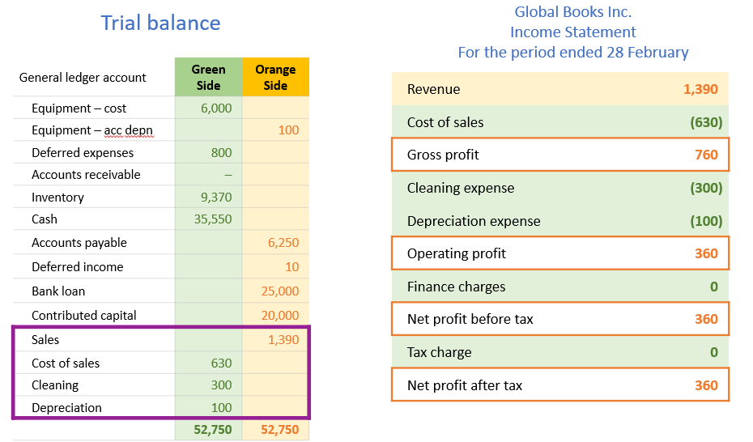
Financial Statement Preparation

Slide 43
Concept Quiz 3
Problem
1. Retained earnings (or Profit Account) is decreased by?
    assets.
    owner's investments.
    expenses.
    revenues.
2. Genesis Company buys equipment for $900 machine on credit (i.e. cash is not paid yet). This transaction will immediately affect the
    income statement and retained earnings statement
    income statement, retained earnings statement, balance sheet.
    income statement only.
    balance sheet only.
3. If an expense is paid with cash,
    expenses will decrease.
    retained earnings will increase.
    assets will decrease.
    liabilities will increase.
Ans: 1. C 2. D 3. C

