Slide 1
Chapter 1: Introducing Financial Accounting

Slide 2
목차
1. 회계 정보에 대한 수요
2. 기업 활동
3. 재무제표와 회계등식
4. 심화: 4대 핵심 재무제표
5. 재무보고 환경
6. 재무제표 분석 (Ratios)
Notes:
We will move through six sections, starting with why we need accounting information, moving through the mechanics of the statements, and finishing with how to analyze those statements using ratios like ROE.

Slide 3
1. Demand for Accounting Information

Slide 4
What is Accounting?
Definition
  financial transactions 를 기록·요약·분석하는 시스템.
Purpose
  경제적 의사결정에 유용한 정보를 제공하기 위함.
Two Categories:
  Financial Accounting: 외부 이용자 (Investors, Creditors).
  Managerial Accounting: 내부 이용자 (Management, Operations).
Notes:
Accounting is more than just math; it is a system of communication. The key distinction is the audience. Financial accounting targets outside decision-makers like banks and shareholders, whereas Managerial accounting is for the internal team running the business.

Slide 5
Information Needs of Decision Makers
Financial Accounting
Managerial Accounting
누가 의사결정자인가?
투자자와 애널리스트
채권자
공급자와 고객
최고경영진
마케팅팀
생산 및 운영
어떤 의사결정을 하는가?
주식 매매 여부?
대출 여부?
상품 구매/판매 여부?
신규 전략 수립?
신제품 출시 여부?
운영 관리
어떤 정보가 필요한가?
매출과 비용
현금 유입과 유출
Assets와 liabilities
제품 매출과 비용
부서별 성과
예산 및 품질 보고서
Notes:
Short Speaker Notes
“This slide highlights the key difference between financial and managerial accounting.”
Who uses the information?
Financial accounting serves external users—investors, lenders, regulators.
Managerial accounting is for internal users—managers who run the business day-to-day.
What decisions are supported?
Financial accounting helps outsiders assess performance, profitability, and overall financial health.
Managerial accounting supports operational decisions—pricing, budgeting, planning, and controlling costs.
What information is used?
Financial accounting relies on historical, GAAP-based, company-wide data.
Managerial accounting uses future-oriented, flexible, detailed information—whatever managers need.
“So in short: financial accounting looks outward and backward; managerial accounting looks inward and forward.”

Slide 6
Users of Accounting Information
기업
현재 주주 및 이사
잠재적 주주
정부 기관
공급자
고객
경영자 및 직원
채권자
재무 애널리스트
Notes:
Different users have different needs. Shareholders want to know if they should invest. Creditors, like banks, just want to know if they will get their money back. Analysts act as intermediaries, interpreting this complex info for the market.
Shareholders & Potential Shareholders
Use info to decide whether to invest or keep investing.
Rely on financial statements to evaluate company performance since they don’t manage operations.
Creditors & Suppliers
Banks, lenders, and suppliers assess ability to repay loans or honor contracts.
Financial info helps determine credit terms, interest rates, and supplier relationships.
Managers & Directors
Use statements as a performance “report card.”
Boards review operations and strategy; managers use info for planning, bonuses, and comparisons with other companies.

Slide 7
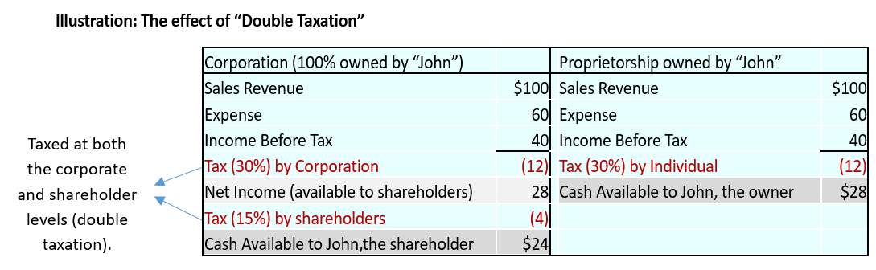
Forms of Business Organization
Sole Proprietorship 소유주 1인이 소유하며 모든 위험을 부담.
Partnership 2인 이상이 소유하며 이익/손실을 공유.
Corporation 별도의 법적 실체.
  Advantage - 유한책임, 자본 조달이 용이.
  Disadvantage: 이중과세.
Notes:
For accounting purposes, the Corporation is the most complex but allows for limited liability. This means owners can only lose what they invest, not their personal assets. However, they face double taxation on profits and dividends.

Slide 8
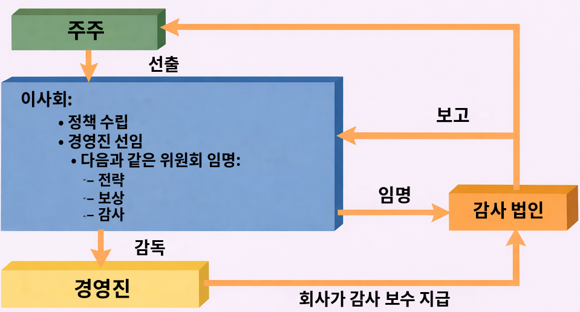
Corporate Governance Structure
Notes:
“This diagram shows how corporate governance works.”
Stockholders elect the Board of Directors.
The Board sets policy, hires top executives, and forms key committees like audit, compensation, and strategy.
Executive managers run the day-to-day business and report back to the board.
The Audit Committee appoints the external Audit Firm, which examines the company’s financial statements.
Even though the company pays the audit fees, the auditor reports directly to the board, helping maintain independence.
“Overall, it’s a system of checks and balances: owners oversee the board, the board oversees management, and auditors help ensure honest financial reporting.”

Slide 9
The Supply of Information
Primary Source of Accounting Information for Public companies
  10-K: 감사받은 연차 보고서 (가장 포괄적인 자료).
  10-Q: 감사받지 않은 분기 보고서 (적시 업데이트).
Why Companies Disclose more Information than Required
  기업은 효익이 비용을 초과할 때 회계 정보를 제공함.
Notes:
*Together, these filings are the main accounting information available to investors, analysts, and the public.

Slide 10
The Supply of Information (continued)
공시의 효익
자본 비용을 낮춤 (더 저렴한 debt/equity)
공급자 및 고객 관계를 강화함
시장 가시성을 높임
공시의 비용
작성 및 규정 준수 비용 (audits, SEC filings).
전략 노출로 인한 경쟁 위험.
Notes:
*Together, these filings are the main accounting information available to investors, analysts, and the public.

Slide 11
2. Business Activities

Slide 12
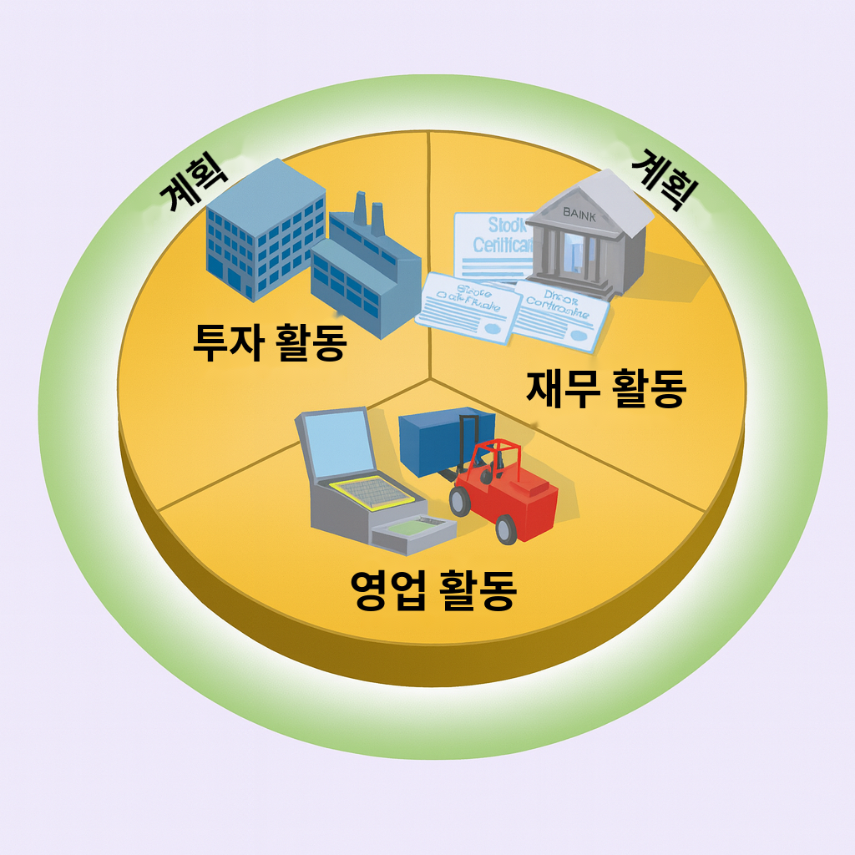
Business Activities
Financing Activities
  소유주(Equity) 또는 채권자(Debt)로부터 자금을 조달.
Investing Activities
  자금을 사용하여 자원(Assets – inventory 또는 equipment)을 취득.
Operating Activities
  재화/용역을 생산하는 일상적 활동.
Notes:
Business is a cycle.
A business organizes its efforts around three main types of activities: financing, investing, and operating. Together, these activities enable the business to achieve its primary objective — creating value and generating wealth.
First, you Finance (get money). Second, you Invest (buy machines/buildings). Third, you Operate (sell goods). This cycle repeats to generate wealth.

Slide 13
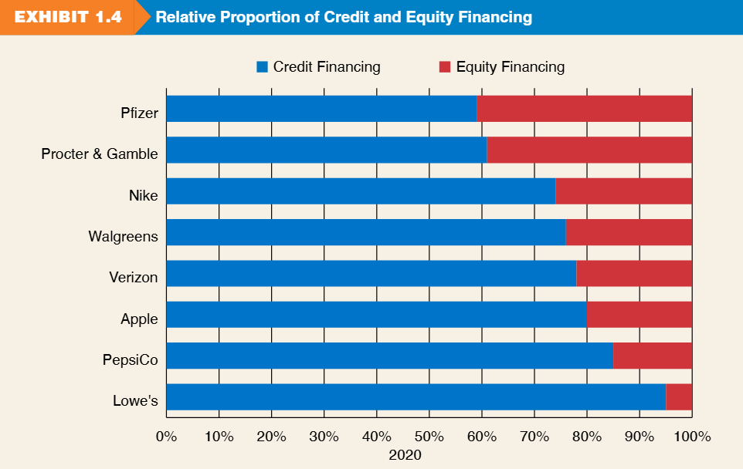
Financing Strategies
기업마다 credit financing과 equity financing의 조합이 다름.
  Pfizer/Nike: 균형잡힌 조합.
  Lowe's: credit financing 의존도가 높음 (>90%).
  Alphabet/Facebook: equity 의존도가 높음.
Notes:
Referencing Exhibit 1.4, we see that capital structure varies by industry. Some companies like Lowe's borrow heavily, while others like Apple rely more on equity.

Slide 14
3. The Four Financial Statements

Slide 15
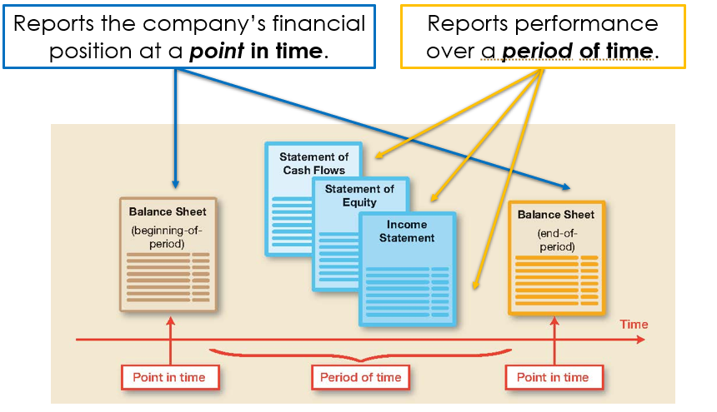
Four Financial Statements
Balance Sheet
  특정 시점의 투자(assets)와 financing 현황.
Income Statement
  일정 기간의 영업 성과.
Statement of Stockholders' Equity
  소유주 financing의 변동.
Statement of Cash Flows
  cash의 원천과 사용.
Notes:
These are the 'Big Four' documents. The Balance Sheet is a snapshot photo. The Income Statement is a video recording of performance over the year.

Slide 16
4. Deep Dive: The Four Core Statements

Slide 17
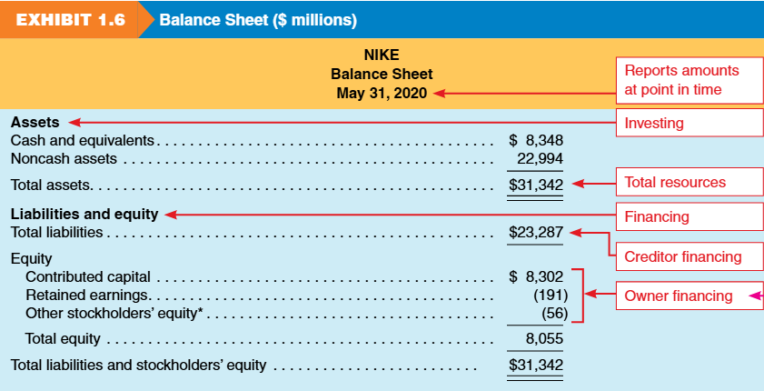
Balance Sheet
Balance sheet는 특정 시점의 회사 financial position을 보고함.
assets, liabilities, equity의 세 요소와 각 요소의 하위 항목을 나열함.
investing 및 financing activities의 결과를 요약함.
Notes:
This is the 'Position Statement.' It tells us what the company owns and owes on a specific day, like December 31st. It summarizes investing and financing activities.

Slide 18
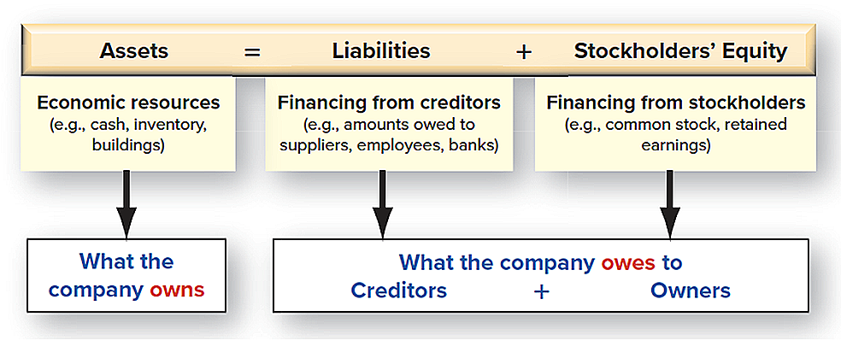
Balance Sheet
The Basic Accounting Equation for Balance Sheet
Notes:
This is the 'Position Statement.' It tells us what the company owns and owes on a specific day, like December 31st. It summarizes investing and financing activities.

Slide 19
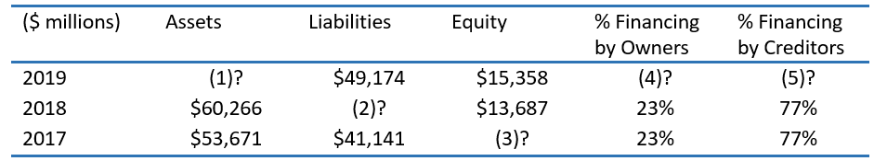
Review Problems 2 –the Accounting Equation
아래 Delta Air Lines, Inc.의 각 연도별 누락된 금액과, 소유주 및 채권자가 제공한 financing 비율을 구하시오.
Notes:
This is the 'Position Statement.' It tells us what the company owns and owes on a specific day, like December 31st. It summarizes investing and financing activities.

Slide 20
Income Statement
The Income Statement reports
  회사 operating activities의 성과
  일정 기간에 걸친
여러 다른 명칭으로 불림.
  Statement of Earnings
  Profit and Loss Statement (P&L)
  Statement of Operations
Income Statement Elements: Revenue and Expense
  Revenue = 재화/용역 판매로 인한 equity 증가
  Expense = revenue를 창출하기 위한 비용.
  Net income = revenues – expenses.
Difference with balance sheet:
  Balance sheet = 특정 시점의 상태.
  Income statement = 일정 기간의 성과.
Notes:
*Together, these filings are the main accounting information available to investors, analysts, and the public.

Slide 21
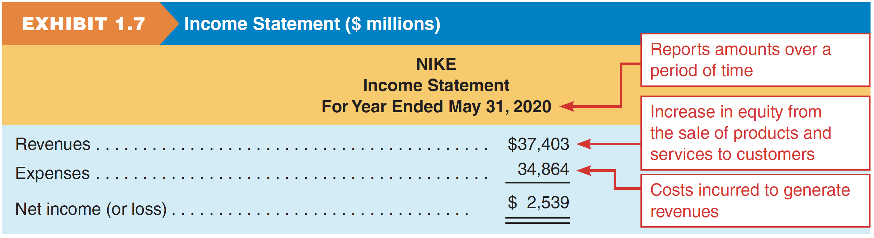
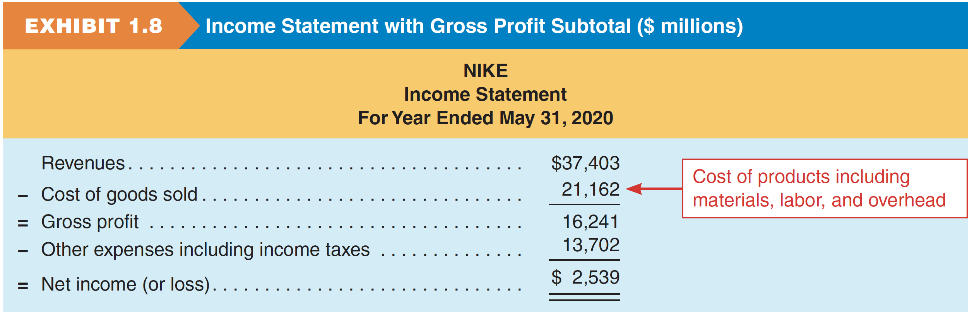
Income Statement
Nike의 회계연도(fiscal year, 2020/5/31 종료) 이익은 $2,539 million임.
A more detailed format:
Notes:
Nike’s profit is $2,539 million for its fiscal year ending May 31, 2020.

Slide 22
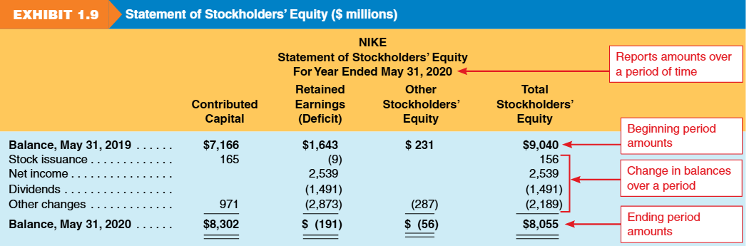
Statement of Stockholders' Equity
시간에 따른 equity 계정의 변동을 보여줌.
Main Components
  Contributed Capital
    stock 발행으로 유입된 금액.
  Retained Earnings
    누적 net income에서 dividends를 차감한 금액.
    income statement와 balance sheet를 연결함.
  Other Equity Items
    net income에 포함되지 않은 조정 항목.
Structure
  두 가지 차원으로 표시됨:
    Vertical: 시간에 따른 변동
    Horizontal: equity 범주
Notes:
This explains how the owners' stake changed during the year. Did the owners put more money in (Stock Issuance)? Did the company make profit (Net Income)? Did they pay cash out to owners (Dividends)?.
Nike’s paid out $1,491 million of its profit as dividends to shareholders during its fiscal year ending May 31, 2020.

Slide 23
Statement of Cash Flows
Statement of cash flows는 일정 기간의 operating, investing, financing activities로부터의 net cash flows를 보고함.
인식 시점과 현금 수취/지급 시점의 차이로 인해 operating cash flow ≠ net income임.
cash flow와 net income은 기업 성과의 서로 다른 측면을 반영하므로 의사결정에 모두 필수적임.
Notes:
Profit is not the same as Cash. You can make a sale on credit (Revenue) but not get the cash for 30 days. This statement tracks the actual movement of hard cash.

Slide 24
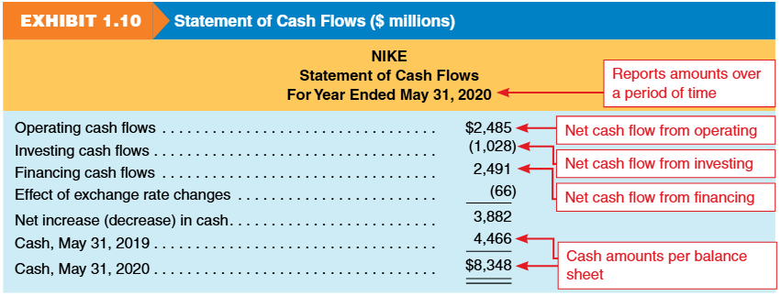
Statement of Cash Flows
Notes:
Profit is not the same as Cash. You can make a sale on credit (Revenue) but not get the cash for 30 days. This statement tracks the actual movement of hard cash.

Slide 25
Articulation of Financial Statements
How the statements connect (the Flow):
  Income Statement에서 Net Income이 산출됨.
  Net Income은 Statement of Equity(Retained Earnings)로 유입됨.
  기말 Equity는 Balance Sheet로 반영됨.
  Cash의 변동(Cash Flow Stmt)은 Balance Sheet의 Cash와 일치함.
Notes:
These documents talk to each other. You cannot finish the Balance Sheet until you know the Ending Equity. You cannot know Equity until you know Net Income from the Income Statement.

Slide 26
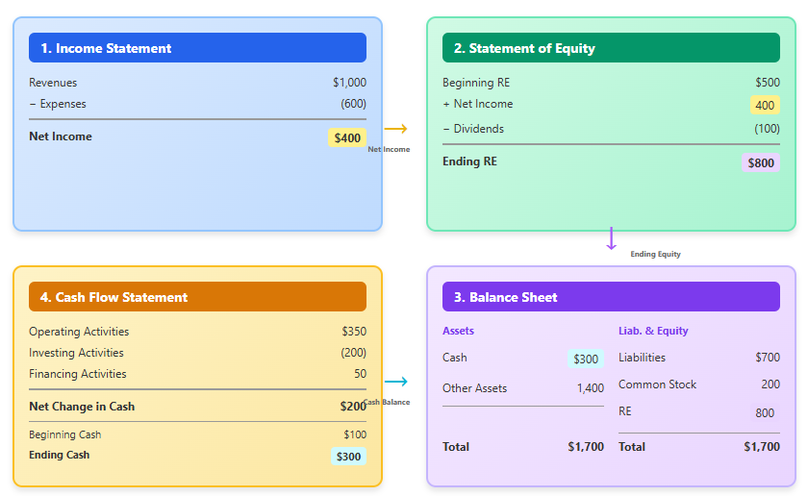
Articulation of Financial Statements
Notes:
These documents talk to each other. You cannot finish the Balance Sheet until you know the Ending Equity. You cannot know Equity until you know Net Income from the Income Statement.

Slide 27
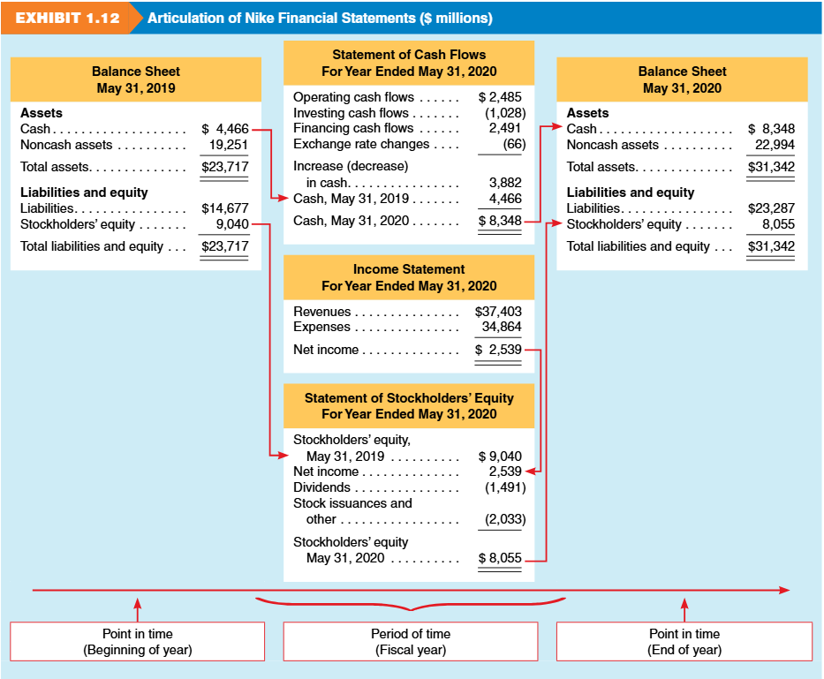
Articulation of Nike Financial Statements
(10)
(2)
(3)
(4)
(11)
(1)
(5)
(6)
(7)
(9)
Notes:
These documents talk to each other. You cannot finish the Balance Sheet until you know the Ending Equity. You cannot know Equity until you know Net Income from the Income Statement.

Slide 28
Information Beyond Financial Statements
Management Discussion and Analysis (MD&A)
Independent auditor report
Financial statement footnotes
Regulatory filings, including proxy statements and other SEC filings
Environmental, Social, and Governance (ESG) reporting
Nike’s 10-K Report (2024):
https://investors.nike.com/investors/news-events-and-reports/default.aspx
Notes:
These documents talk to each other. You cannot finish the Balance Sheet until you know the Ending Equity. You cannot know Equity until you know Net Income from the Income Statement.

Slide 29
Review Problem 3: Samsung Electronics
다음은 Apple의 경쟁사인 Samsung Electronics의 2022년 12월 31일 기준 재무정보임 (단위: 십억 Korean won).
Required: Samsung Electronics의 2022년 12월 31일 종료 연도에 대한 income statement와 statement of cash flows를 작성하고, 2022년 12월 31일 기준 balance sheet를 작성하시오.
Item | Amount (₩ billions)
Short-term liabilities | 78,345
Cash flows used in financing | (19,928)
Revenues | 302,231
Stockholders' equity | 354,750
Cash flows from operations | 62,181
SG&A expenses | 68,813
Long-term assets | 229,954
Interest income | 3,064
Cost of goods sold | 190,042
Cash, beginning-year | 39,031
Provision for income taxes | (9,214)
Short-term assets | 218,471
Long-term liabilities | 15,330
Cash, ending year | 49,681
Cash flows used in investing | (31,603)
Notes:
In this exercise, we take raw data and organize it. Note that Assets equal Liabilities plus Equity (448,425). This confirms our Balance Sheet is balanced.

Slide 30
5. Financial Reporting Environment

Slide 31
Generally Accepted Accounting Principles (GAAP)
financial statements 작성을 안내하기 위해 마련된 기준 및 관행.
기본 원칙(GAAP)에 근거함.
작성 시 상당한 재량을 허용함.
외부 이용자가 감사받은 financial statements를 신뢰할 수 있게 함.
이 financial statements는 GAAP에 따라 작성되었으며 감사를 받았습니다!

Slide 32
Regulation and Oversight – the SEC
Securities Act of 1934
created
Securities & Exchange Commission (SEC)
The SEC’s Authority
  미국 내 securities의 발행과 거래를 규제함.
Who must report to the SEC?
  assets가 $10 million을 초과하고 securities 보유자가 500명을 초과하는 기업은 연차 및 기타 정기 보고서를 제출해야 함.

Slide 33
Regulation and Oversight - FASB
Financial Accounting Standards Board
현재 미국의 accounting standards를 제정함.
기준에서 다루지 않는 회계 이슈의 지침으로 삼기 위해 Conceptual Framework를 개발함.
회계 실무에서 FASB로 불림.

Slide 34
Management and Auditors
경영진
재무제표를 작성함.
재무제표에 공시된 내용에 대해 책임을 짐.
독립 감사인
정확성과 완전성을 보증하기 위해 재무제표를 감사(audit)함.
정확성에 대한 '의견(opinion)'을 제시함.
상장기업의 재무제표는 독립적인 audit firm의 감사를 받아야 함.
audit opinion이 보증을 의미하지는 않음.
Notes:
It is a common misconception that auditors are responsible for the numbers. Management is responsible. Auditors just check the work to provide reasonable assurance.
“Audit” financial statements
As assurance of accuracy and completeness, financial statements of publicly traded companies must be audited by an independent audit firm.

Slide 35

Regulation and Oversight - Sox
Sarbanes-Oxley Act (SOX) of 2002
신뢰할 수 없는 financial reporting에 대한 우려를 해소하기 위해 Congress가 제정함.
기업 financial statements에 대한 투자자 신뢰를 회복하는 것을 목표로 함.
다음을 위해 PCAOB를 설립함:
  auditing standards를 설정하고 승인함.
  audit 품질과 GAAP 준수 여부를 감독함.
Notes:
Sarbanes-Oxley Act of 2002
Referred to as SOX by the accounting profession.
Developed by Congress due to concerns over the quality of corporate financial reporting.
Goal was to increase the level of confidence that external users have in financial statements.
SOX then established the Public Accounting Oversight Board (PCAOB) to approve auditing standards and to monitor the quality of financial statements and audits (GAAP).

Slide 36
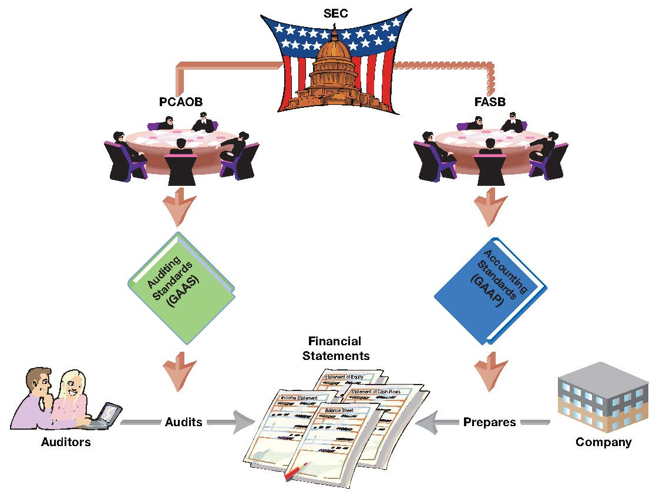
Regulation and Oversight - Sox
Notes:
Sarbanes-Oxley Act of 2002
Referred to as SOX by the accounting profession.
Developed by Congress due to concerns over the quality of corporate financial reporting.
Goal was to increase the level of confidence that external users have in financial statements.
SOX then established the Public Accounting Oversight Board (PCAOB) to approve auditing standards and to monitor the quality of financial statements and audits (GAAP).

Slide 37
Global Perspective (GAAP vs. IFRS)
Why Global Standards Exist
  글로벌 capital markets에는 비교 가능한 financial information이 필요함.
  기업의 비용을 줄이고 투자자에 대한 투명성을 높임.
Key Standard Setters
  FASB – U.S. GAAP를 제정.
  IASB – IFRS를 제정하며, 100개국 이상(EU, UK, Canada, Japan)에서 사용.
GAAP vs. IFRS
  둘 다 동일한 core statements(BS, IS, CF, Equity)를 산출함.
  세부 규정과 처리는 다르지만 유사한 개념을 공유함.
Adoption and Use
  100개국 이상이 IFRS를 의무화하며, 모든 EU 국가가 사용함.
  SEC는 외국 기업이 U.S. GAAP 조정 없이 IFRS로 제출하는 것을 허용함.
Comparability & Convergence
  과거 공동 프로젝트(leases, revenue, financial instruments).
  현재 활발한 convergence는 없으나 비교가능성은 여전히 우선순위임.
Notes:
Business is global. While the US uses GAAP, most of the world uses IFRS. The goal is for an investor in New York to easily compare a company in London with one in Tokyo.

Slide 38
Review Problem 4: Regulatory Roles
다음 각 용어를 financial reporting과의 관계를 가장 잘 설명하는 내용과 연결하시오.
Terms: (a) Auditor, (b) FASB, (c) GAAP, (d) Internal controls, (e) Management, (f) PCAOB, (g) SEC
1. _____ 미국에서 financial statements 작성을 안내하는 권위 있는 기준 및 관행의 집합.
2. _____ financial reporting에 대해 최종 권한을 가진 기관.
3. _____ 현재 financial reporting을 안내하는 새로운 accounting standards를 성문화함.
4. _____ auditing standards를 승인하고, 연차 실적 보고가 요구되는 상장기업의 audit을 감독함.
5. _____ financial statements에 공시된 정보의 정확성과 완전성에 대해 책임을 짐.
6. _____ 회사 financial reporting의 공정한 표시에 대해 의견을 제시함.
7. _____ 내부 감시 절차와 규칙 체계를 통해 회사 financial reporting의 정확성을 확보하도록 도움.
Notes:
A quick check on the ecosystem. FASB writes the rules. SEC enforces them. PCAOB watches the auditors. Management owns the data.

Slide 39
6. Analyzing Financial Statements

Slide 40
Analyzing Financial Statements
Why Analysis and Interpretation Matters
  raw numbers(net income, liabilities 등)는 맥락 없이는 의미가 없음.
  Financial statements는 성과를 보여주지만 이해하려면 분석이 필요함.
Role of Ratios
  규모와 관계없이 기업 간 비교를 도움.
  추세, profitability, 잠재적 위험을 드러냄.
Notes:
Is a $1 million profit good? For a small bakery, yes. For Apple, no. Ratios turn absolute numbers into comparable percentages to provide this context.

Slide 41
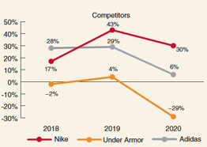
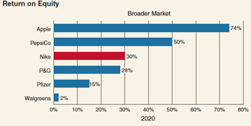
Profitability Analysis (ROE)
Return on Equity (ROE)
  기업이 stockholders를 위해 수익을 창출하는 능력을 측정함.
Formula
  ROE = Net Income / Average Stockholders' Equity.
Nike Example
  ROE 30-42%. (Guidance: >10 % is strong).
Takeaways: Nike ROE
  Strong Performance
    ROE: 42% (2019) and ~30% (2020).
    주요 경쟁사(Adidas, Under Armor)를 크게 상회함.
  What It Means
    높은 ROE → 강한 shareholder returns.
    지속적인 리더십은 꾸준한 product innovation에 달려 있음.
Notes:
ROE tells shareholders how well their money is being used. Nike's exceptionally high ROE indicates it is very efficient at generating profit from shareholder capital.

Slide 42
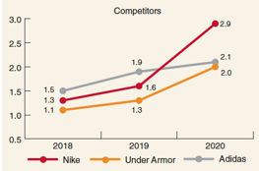
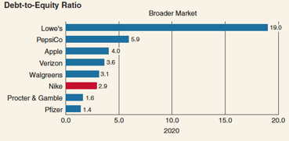
Credit Risk Analysis (D/E Ratio)
Purpose
  기업에 투자하거나 대출할 때의 위험을 평가함.
  장기 solvency가 핵심이며, Debt-to-Equity(D/E) ratio로 측정됨.
Analysis Focus
  Objective: 이자와 원금 지급 능력을 평가함.
  Tool:
    D/E = Total Liabilities ÷ Total Equity
    Nike: 1.30 (2018) → 1.62 (2019) → 2.89 (2020)
Interpretation
  D/E가 높을수록 debt 의존도와 파산 위험이 커짐.
  Nike의 D/E 상승은 liabilities가 equity보다 빠르게 증가함을 보여줌.
Takeaways
  Nike의 2020년 D/E는 경쟁사를 초과함.
  높은 ROE는 부분적으로 debt financing 증가에 기인함.
Notes:
This measures risk. Nike took on more debt relative to equity over these three years. While this increases risk, it can also boost ROE if the borrowed money is invested wisely.

Slide 43
Review Problem 5: Adidas vs. Nike
Nike의 주요 경쟁사인 Adidas는 Adidas 및 Reebok 브랜드로 운동화와 의류를 판매함. 또한 Solomon 스키 장비와 TaylorMade 골프 장비도 판매함. 다음 정보는 Adidas의 2019년 financial statements에서 발췌한 것임 (Adidas의 financial statements는 European Union의 통화인 Euros로 보고됨):
Required :
a. Adidas의 2019년 return on equity(ROE) ratio를 계산하시오.
b. Adidas의 2019년 debt-to-equity ratio를 계산하시오.
c. Adidas와 Nike의 profitability와 위험을 비교하시오. 참고: 분석 시 Nike의 FY 2020 재무제표(2020년 5월 31일 종료 12개월)와 Adidas의 2019년 재무제표(2019년 12월 31일 종료 12개월)를 비교하시오.
(millions) | Adidas
Net income (loss) (2019) | € 1,977
Stockholders’ equity (2019 year-end) | 7,058
Stockholders’ equity (2018 year-end) | 6,364
Total liabilities (2019 year-end) | 13,622
Notes:
Here we see the power of ratios. We can compare Adidas (Euros) to Nike (Dollars) directly. They have similar profitability, but Nike is carrying significantly more debt/risk.

