Slide 1
Chapter 3: Adjusting Accounts for Financial Statements

Slide 2
목차
  Part 1: Cash Basis vs. Accrual Basis 회계
  1. Business Cycle ≠ Reporting Cycle일 때 발생하는 보고 이슈
  2/3. Illustration 1 & 2: Accrual Basis 하에서 Revenue·Expense 인식
  4. Cash vs. Accrual Basis 회계
  Part 2: Adjusting Entries
  5. 왜 Adjustments가 필요한가?
  6. Adjustments의 네 가지 유형
  7. Deferred Expenses는 Assets
    8. Accrued Expenses는 Liabilities
Notes:
We will move through six sections, starting with why we need accounting information, moving through the mechanics of the statements, and finishing with how to analyze those statements using ratios like ROE.

Slide 3
1. Reporting Issues when the Business Cycle ≠ Reporting Cycle

Slide 4
The Accounting Period & Business Cycles
The Accounting Period (Reporting Cycle)
재무 성과를 측정·기록·보고하는 시간 간격
두 개의 balance sheet 사이의 기간
한 달, 분기, 또는 1년이 될 수 있음.
Business Operating Cycle
기업이 다음을 수행하는 데 걸리는 평균 시간: 재고 매입/생산 → 판매 → 현금 회수
영업 순환(operating cycle)은 연속적이며 실제로 결코 '멈추지' 않음

Slide 5
The Periodicity Assumption
GAAP은 기업의 경제적 생애가 보고 목적상 인위적인 기간(월·분기·연)으로 나눌 수 있다고 가정함
Purpose
이해관계자(stakeholders)가 관리 가능하고 비교 가능한 구간에 걸쳐 성과를 평가할 수 있게 함
Activities into a Period
회계담당자는 연속적인 활동을 더 짧고 일관된 구간으로 '잘라' 성과를 정기적으로 보고함

Slide 6
What is an Issue?
The Challenge
수익 창출 활동은 연속적으로 발생하지만, financial statements는 특정 기간의 말에 작성되어야 함
If Aligned
If Not Aligned
✓ No reporting issues
✗ Critical reporting issues arise
✗ This is the reality we face

Slide 7
2 & 3. Illustration
When to Recognize Revenues and Expenses

Slide 8
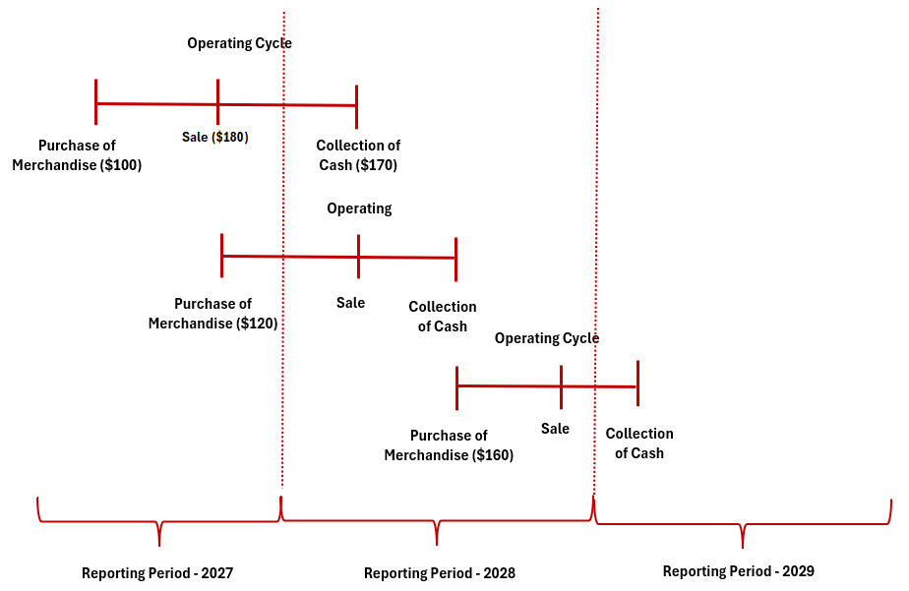
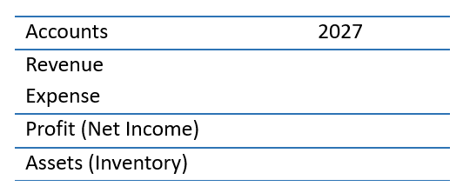
Illustration 1 –
When to Recognize Revenue & Expenses
회계기간은 12/31에 종료됨
12/1/27 Purchase merchandise for $100 cash
12/20/27 Sell merchandise for $180 on credit
1/15/28Collect $180 cash from customer
Question:
이 회사는 2027년에 revenue, expense, asset을 각각 얼마로 인식해야 하는가?
$180
$100
$ 80
$120
Notes:
Accounting is more than just math; it is a system of communication. The key distinction is the audience. Financial accounting targets outside decision-makers like banks and shareholders, whereas Managerial accounting is for the internal team running the business.

Slide 9
Illustration 2 – Summit Publishing Company Case
Background
Summit Publishing Company는 잡지 출판 및 유통을 전문으로 함. 이 회사는 분기별 출판 일정으로 운영됨.
Subscription Details
Total Cash Collection
Publication Frequency : 4 issues/ year)
Price per Issue : $25
Number of Subscribers : 1,000
Subscription Length : 3 years
Total subscription related cash collection for 3-year subscription in 2025: $300,000
That is, $25 × 4 issues × 1,000 subscribers × 3 years = $300,000
Operating Costs
Financing Costs
Annual magazine production and delivery cost: $60,000
이 회사는 연 10% 이자(연 $10,000)로 3년 만기 $100,000 대출을 받음.
Payment Terms: 원금과 이자는 대출 만기 시 상환 예정
Notes:
Accounting is more than just math; it is a system of communication. The key distinction is the audience. Financial accounting targets outside decision-makers like banks and shareholders, whereas Managerial accounting is for the internal team running the business.

Slide 10
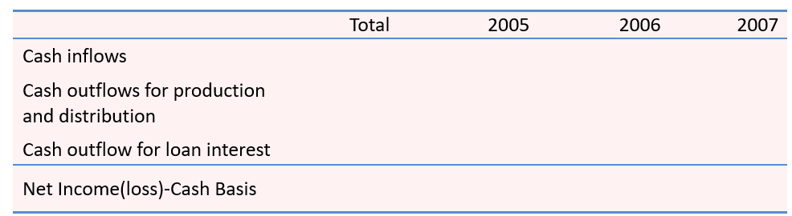
Illustration 2 – Summit Publishing Company Case
Required
1. 3년 기간(2025-2027) 동안 회사의 total income을 계산하시오
2. 각 연도(2025, 2026, 2027)의 annual income을 구하시오
Notes for Analysis
Summit Publishing Company의 annual income을 계산하는 가장 좋은 방법은 무엇인가?
Note : Income = Revenue – Expenses
Notes:
Accounting is more than just math; it is a system of communication. The key distinction is the audience. Financial accounting targets outside decision-makers like banks and shareholders, whereas Managerial accounting is for the internal team running the business.

Slide 11
Two Ways to Keep Score: Cash vs. Accrual Basis
Cash Basis (Not GAAP)
Definition: accrual이나 deferral을 기록하지 않음
Revenue Recognition: 현금을 받을 때만 revenue를 기록
Expense Recognition: 현금을 지급할 때만 expense를 기록
Focus: 현금 유입·유출 — 단순한 유동성 관점
Accrual Basis (GAAP)
Definition: 경제적 활동에 기반한 인식
Revenue Recognition: 재화가 판매되거나 용역이 제공될 때 revenue를 인식하며,
현금이 회수될 때가 아님
Expense Recognition: 관련 revenue와 같은 기간에, 또는 효익이
소멸할 때 expense를 인식
Focus: 거래의 경제적 실질

Slide 12
Illustration 2 – Summit Publishing Company Case
Summit Publishing: Cash-basis summary
90,000
Notes:
Accounting is more than just math; it is a system of communication. The key distinction is the audience. Financial accounting targets outside decision-makers like banks and shareholders, whereas Managerial accounting is for the internal team running the business.

Slide 13
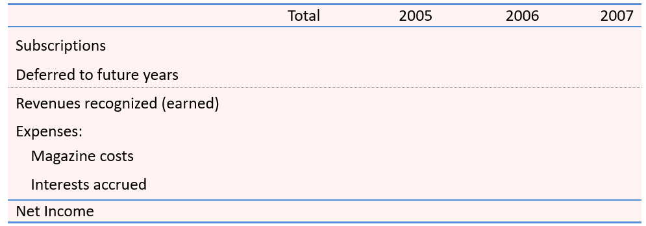
Illustration 2 – Summit Publishing Company Case
Summit Publishing: Accrual-basis summary
$300,000
(180,000)
30,000
90,000
Notes:
Accounting is more than just math; it is a system of communication. The key distinction is the audience. Financial accounting targets outside decision-makers like banks and shareholders, whereas Managerial accounting is for the internal team running the business.

Slide 14
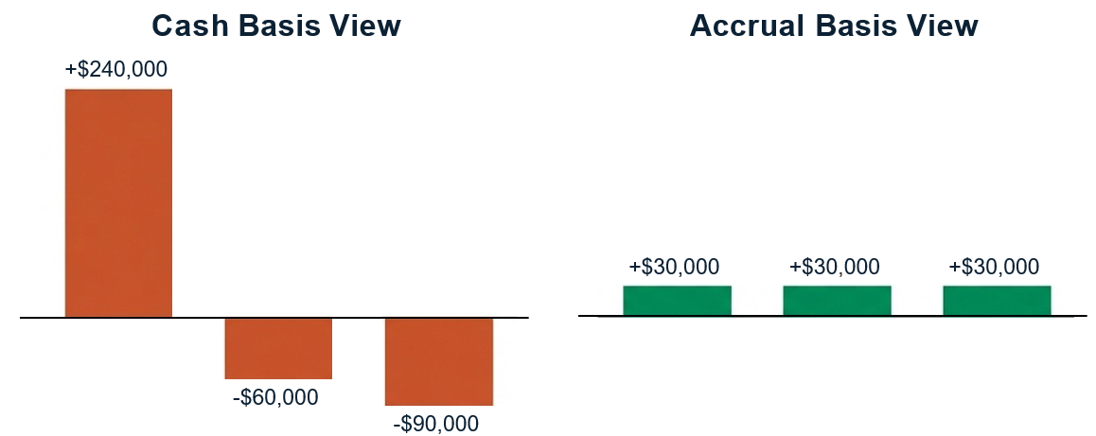


Illustration 2 – Summit Publishing Company Case
Cash Basis는 성과를 왜곡하고, Accrual은 성과를 드러냄
안정적이고 예측 가능함.
위험하고 변동성이 커 보임.
2025 2026 2027 2025 2026 2027
Cash는 은행 계좌를 추적하고, Accrual은 비즈니스 모델을 추적함.
Notes:
Accounting is more than just math; it is a system of communication. The key distinction is the audience. Financial accounting targets outside decision-makers like banks and shareholders, whereas Managerial accounting is for the internal team running the business.

Slide 15
Cash vs. Accrual Basis : Comparison
Limitations of Cash Basis
영업 활동 이후 인식이 지연됨
expense와 revenue의 대응이 부적절함
긴 영업 순환에 더 불리함
Advantages of Accrual Basis
기간별 수익성을 더 명확하게 보여줌
expense와 revenue를 더 잘 대응시킴
실제 영업 성과를 반영함

Slide 16
Concept Quiz 1
1.
서비스 회사에서 revenue는 다음 시점에 기록된다:
  a customer requests services.
  a customer pays for the services.
  the services are performed for the customer.
  a customer pays a nonrefundable deposit before the services are performed.
2.
20x3년에 Costello Company는 고객을 위해 업무를 수행하고 고객에게 $10,000를 청구함. 또한 $3,000의 비용을 지급함. 고객은 20x4년에 Costello에 지급함. Costello가 accrual-basis 회계를 사용한다면, Costello는 다음을 보고할 것임:
  expenses of $3,000 in 20x4.
  net income of $7,000 in 20x4.
  revenue of $10,000 in 20x3.
  revenue of $10,000 in 20x4.
Notes:
Historical cost method
Some assets remain at historical cost on the balance sheet regardless of the current fair value
Example: Land, Inventory, and Equipment
Historical cost is reliable but often significantly undervalued
Fair Value Method
Some assets are reported at current fair value
Example: Marketable securities
Fair value is reliable and objective because of real-time stock quotes.

Slide 17
Concept Quiz 1 (Continued)
3.
Delta Airline의 직원들은 매월 15일에 급여를 받음. 20x1년 12월 16일부터
12월 31일까지 직원들은 $220,000를 벌었으나, 이는 20x2년 1월 15일까지 지급되지 않음.
다음에 대한 journal entry를 작성하시오: (1) 12월 16일~12월 31일 사이 발생한 직원 임금을
기록하는 20x1년 12월 31일 분개, (2) 직원 임금을 지급하는 20x2년 1월 15일 분개.
Solution:
Notes:
Historical cost method
Some assets remain at historical cost on the balance sheet regardless of the current fair value
Example: Land, Inventory, and Equipment
Historical cost is reliable but often significantly undervalued
Fair Value Method
Some assets are reported at current fair value
Example: Marketable securities
Fair value is reliable and objective because of real-time stock quotes.

Slide 18
5. Why Adjustments are Needed?

Slide 19

Adjustments Align the Facts with the Financials
Daily Cash Transactions
Financial
Statements
ADJUSTING ENTRIES
The Time Gap (Periodicity)
Isl\ NotebookLM

Slide 20

Cash Flow Does Not Equal Business Performance
'Expense'(비용)는 실제로 돈이 은행 계좌에서 나가는 시점과 무관하게, 가치의 소비로 정의됨.
현금만 추적하면 수익성에 대한 잘못된 그림을 만듦.
Cash Paid
The Cash Trap
Value Used
Notes:
Accounting is more than just math; it is a system of communication. The key distinction is the audience. Financial accounting targets outside decision-makers like banks and shareholders, whereas Managerial accounting is for the internal team running the business.

Slide 21

The Two Directions of Time
Activity
(Value Consumed)
1. Activity 이전에 현금 지급
(Deferred Expense/ Asset)
2. Activity 이후에 현금 지급
(Accrued Expense / Liability)
Notes:
Accounting is more than just math; it is a system of communication. The key distinction is the audience. Financial accounting targets outside decision-makers like banks and shareholders, whereas Managerial accounting is for the internal team running the business.

Slide 22
Four Types of Adjustments
Activity 이전에 현금 지급
Activity 이후에 현금 지급
Expense
Deferred Expenses = Assets
(e.g. Prepaid Advertising Expenses)
Accrued Expenses = Liabilities
(e.g. Accrued Interest Expenses)
Revenue
Deferred Revenue
Accrued Revenue
본 발표에서는 Expense 측면에만 집중함.
Notes:
Accounting is more than just math; it is a system of communication. The key distinction is the audience. Financial accounting targets outside decision-makers like banks and shareholders, whereas Managerial accounting is for the internal team running the business.

Slide 23
7. Deferred Expenses are Assets

Slide 24
Deferred Expenses are Assets
Concept
현금 지급이 여러 회계기간에 걸쳐 효익을 제공할 때, 그 금액은 먼저 asset(deferred expense)으로 기록됨
Process
각 기간 말에, 소멸된 부분은 expense 계정으로 대체됨
asset(deferred expense)은 동일한 금액만큼 감소함
Common Examples
Buildings, equipment, supplies, prepaid insurance, prepaid rent
Notes:
Accounting is more than just math; it is a system of communication. The key distinction is the audience. Financial accounting targets outside decision-makers like banks and shareholders, whereas Managerial accounting is for the internal team running the business.

Slide 25
Illustration 1 – Deferred Advertising Expense
28 February
Global Books, Inc.
13
800
800
3월부터 6월까지 진행될 광고 캠페인 대금을 은행 이체로 지급함.
Deferred expenses
800
Cash
800

Slide 26
Global Books, Inc.
Uses of funds
Sources of funds
_Assets
Liabilities_
11
600
8a
600
13
800
Accounts receivable
9
250
12a
90
3
5,000
11
600
4
6,000
10
100
1
30,000
10
100
Accounts payable
Deferred revenue
Bank loan
50
13
800
7
6a
700
Deferred expenses
Equity_
5
10,000
12b
30
3
5,000
8b
300
Profit
2
20,000
6b
300
460
4
6,000
1
30,000
5
10,000
2
20,000
Equipment
Cash at bank
Inventory
Contributed capital
13
800
800
3월부터 6월까지 진행될 광고 캠페인 대금을 은행 이체로 지급함.
Deferred expenses
800
Cash
800
_Expenses
Revenue_
9
250
7
50
Cleaning
12b
30
12a
90
8b
300
8a
600
6b
300
6a
700
Cost of sales
Revenue (sales)
Notes:
They will typically think it is an expense: because we spent money or because advertising is an expense.
Help them work through the logic – refer them to the dates.
We gave the supplier $800. What did they give us in return?
The business has bought the right to receive advertising.
Only if a participant raises the issue: acknowledge that simplified bookkeeping practice can expense the payment immediately, and then – as a closing entry for the period/year - capitalise the portion that is not yet consumed.
Same result at the end of the period but the monthly P&Ls will not reflect the underlying business activities.

Slide 27
Illustration 1 – Continued
31 March
Global Books, Inc.
15
200
200
3월 31일까지 한 달 동안 소비된 deferred advertising을 회계처리함.
Advertising
200
Deferred expenses
200

Slide 28
Calculation of Advertising Amortization
Deferred advertising expense $800
Period of campaign (months) 4 months
Expensed per month (straight line basis) $200

Slide 29
Global Books, Inc.
Uses of funds
Sources of funds
_Assets
Liabilities_
11
600
8a
600
13
800
Accounts receivable
9
250
12a
90
3
5,000
11
600
4
6,000
10
100
1
30,000
100
15
200
Accounts payable
Deferred revenue
Bank loan
10
800
7
50
13
14
100
6a
700
Deferred expenses
Equity_
Accumulated depreciation
5
10,000
12b
30
3
5,000
8b
300
Profit
2
20,000
6b
300
160
360
4
6,000
1
30,000
5
10,000
2
20,000
Equipment
Cash at bank
Inventory
Contributed capital
15
3월 31일까지 한 달 동안 소비된 deferred advertising을 회계처리함.
200
Deferred expenses
200
Advertising
200
200
_Expenses
Revenue_
9
250
7
50
Cleaning
12b
30
12a
90
8b
300
8a
600
14
100
15
200
6b
300
6a
700
Depreciation
Advertising
Cost of sales
Revenue (sales)
Notes:
One quarter of the advertising is consumed, according to the dates and using a straight-line matching/pro rata concept for recognising the expense.

Slide 30

Visualizing the Consumption of Value
Feb28
(Purchase Date)
March31
(First Adjustment)
25%
Expense:$200
April 30
(Second Adjustment)
50%
Expense:$200
Cumulative Expense
The expense is the running of the ads, not the writing of the check.

Slide 31
Illustration 2 – Depreciation Expense
Concept (Depreciation)
유형자산(tangible asset)의 구입은 미래 용역의 묶음을 구입하는 것임.
Depreciation은 유형자산의 원가를 그 내용연수에 걸쳐 체계적으로 배분하는 것임.
Process (Recording Depreciation)
각 기간 말에, 소멸된 부분은 expense 계정(Depreciation expense)으로 대체됨. 자산의 book value는 동일한 금액만큼 감소하며, 일반적으로 Accumulated Depreciation이라는 contra-asset 계정을 사용함
Common Examples (Depreciable Assets)
Buildings, equipment, vehicles, furniture, machinery
Notes:
Accounting is more than just math; it is a system of communication. The key distinction is the audience. Financial accounting targets outside decision-makers like banks and shareholders, whereas Managerial accounting is for the internal team running the business.

Slide 32
Global Books, Inc.
31 January
4
6,000
6,000
ZZZ Suppliers로부터 장비를 구입·설치함. 30일 후 지급 조건임.
Equipment
6,000
Accounts payable
6,000
Notes:
First non-cash event.

Slide 33
Global Books, Inc.
Uses of funds
Sources of funds
_Assets
Liabilities_
3
5,000
4
6,000
1
30,000
Accounts payable
Bank loan
Equity_
3
5,000
Profit
2
20,000
4
6,000
1
30,000
2
20,000
Equipment
Cash at bank
Contributed capital
_Expenses
Revenue_
4
ZZZ Suppliers로부터 장비를 구입·설치함. 30일 후 지급 조건임.
Equipment
6,000
Accounts payable
6,000
6,000
6,000
Notes:
In debrief, work through logic carefully.
New asset and new obligation.
In accounting, we record things as they occur, not necessarily when cash is received or paid.
Today we owe – tomorrow we’ll pay – we record the payment only when it happens.

Slide 34
Illustration 2 – Depreciation Expense (Continued)
31 March
Global Books, Inc.
14
장비는 잔존가치 없이 5년간 사용됨. 한 달치 사용분을 회계처리함.
Depreciation
100
Accumulated depreciation
100
100
100

Slide 35

Depreciation Expense
Original cost of equipment $6,000
Less: estimated residual value $0
Amount to be depreciated $6,000
Estimated useful life of the asset 5yrs/60 mths
Depreciation expense – annual $1,200
Depreciation expense – monthly $100
Expense

Slide 36
Global Books, Inc.
Uses of funds
Sources of funds
_Assets
Liabilities_
11
600
8a
600
13
800
Accounts receivable
9
250
12a
90
3
5,000
Net book value
11
600
4
6,000
10
100
1
30,000
10
100
Accounts payable
Deferred revenue
Bank loan
50
13
800
7
14
100
6a
700
Deferred expenses
Equity_
Accumulated depreciation
5
10,000
12b
30
3
5,000
8b
300
Profit
2
20,000
6b
300
360
460
4
6,000
1
30,000
5
10,000
2
20,000
Equipment
Cash at bank
Inventory
Contributed capital
14
100
장비는 잔존가치 없이 5년간 사용됨. 한 달치 사용분을 회계처리함.
Depreciation
100
Accumulated depreciation
100
_Expenses
100
Revenue_
9
250
7
50
Cleaning
12b
30
12a
90
8b
300
8a
600
14
100
6b
300
6a
700
Depreciation
Cost of sales
Revenue (sales)
Notes:
Monthly depreciation amount is $100 being
$6,000 divided by 60 months.
Depreciation causes a lot of confusion, in part, because it is doing two things at once, and students need to know which part of the transaction they are looking at.
Accounting duality means that depreciation does two things:
– it Books, Inc. the reduction of an asset’s value as it is used up and this “loss of value” accumulates (builds up) in the balance sheet.
This is the “credit”
– it Books, Inc. the sacrifice of value as an expense: the depreciation charge.
This is the “debit”

Slide 37
8. Accrued Expenses are Liabilities

Slide 38

Accrued Expenses are Liabilities
Concept
관련 활동이나 용역이 공급자가 invoice를 발행하기 전에(즉, 현금 지급 전에) 발생하더라도, expense는 인식되어야 함.
지급이 이루어지지 않은 경우, liability를 기록함.
Value Consumed (Expense)
Process
청구되지 않았거나 지급되지 않은 재화·용역의 소비는 accrued liability를 발생시키며, 이는 지급 시 정산됨.
Payment Pending
(Liability)
Common Examples
Utility Payable, accrued interest expense, tax payable
Notes:
Accounting is more than just math; it is a system of communication. The key distinction is the audience. Financial accounting targets outside decision-makers like banks and shareholders, whereas Managerial accounting is for the internal team running the business.

Slide 39
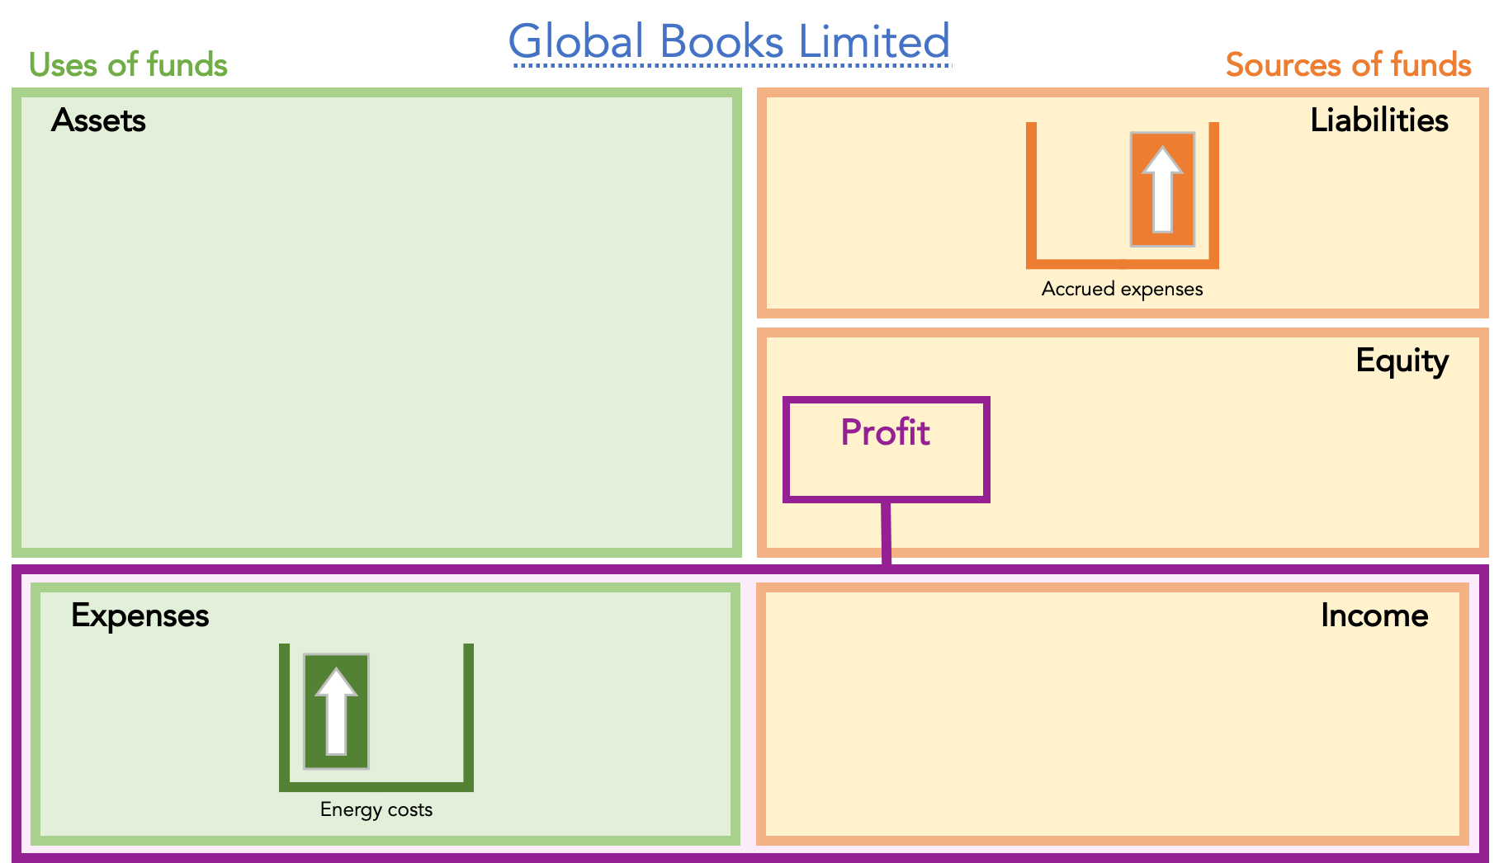
Illustration 3 – Estimated energy costs
31 March
Global Books, Inc.
17
아직 청구되지 않은 3월분 추정 에너지 비용.
110
110
Notes:
In this scenario, Global Books will recognize the energy cost as an expense in March—or in the period when it is used—even if the cash payment will not be made until April.
In March, Global Books records an energy expense and a liability, because payment for March utilities has not yet been made.
This liability is called an accrued expense.
Important: an accrued expense represents liability on the balance sheet.

Slide 40
Illustration 4 – Accrued Interest Expense
Problem
  2027년 7월 1일, 귀사는 은행으로부터 $100,000를 차입함. 이 대출은 3년 만기이며 연 6%의 이자율이 적용됨. 회사의 회계연도는 December 31에 종료됨. 연간 이자 지급일은 2028, 2029, 2030년 6월 30일임.
  7월 1일과 2027년 12월 31일의 거래를 기록하시오
Notes:
Accounting is more than just math; it is a system of communication. The key distinction is the audience. Financial accounting targets outside decision-makers like banks and shareholders, whereas Managerial accounting is for the internal team running the business.

Slide 41
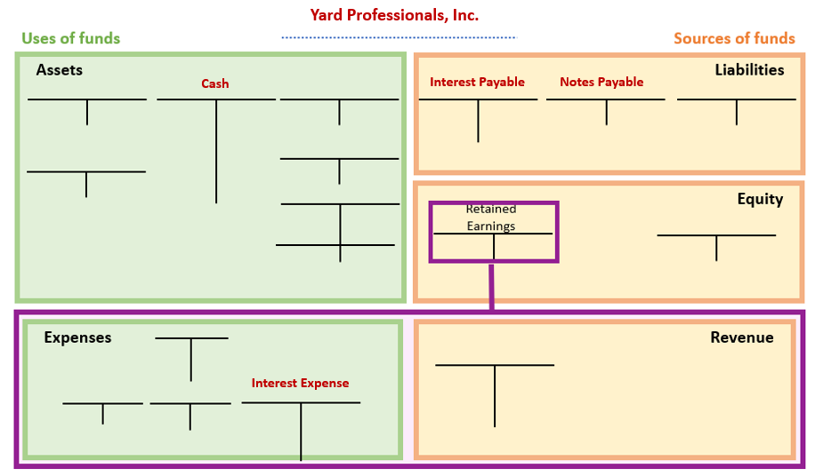
Illustration 4 – Continued
100,000
3,000
100,000
3,000
Notes:
Accounting is more than just math; it is a system of communication. The key distinction is the audience. Financial accounting targets outside decision-makers like banks and shareholders, whereas Managerial accounting is for the internal team running the business.

Slide 42
Concept Quiz 2
1.
서비스가 제공되기 전에 받은 현금은 다음으로 기록된다:
  liabilities.
  expenses.
  equity.
  revenues.
2.
2018년 12월 31일, 연말 조정 전에 MaCarthy Company의 Prepaid Insurance 계정 잔액은 $2,700였음. Prepaid Insurance 중 $1,500가 소멸된 것으로 확인됨. 해당 연도의 Insurance Expense 조정 후 잔액은?
  $2,700
  $1,900
  $1,500
  $1,200
Notes:
Historical cost method
Some assets remain at historical cost on the balance sheet regardless of the current fair value
Example: Land, Inventory, and Equipment
Historical cost is reliable but often significantly undervalued
Fair Value Method
Some assets are reported at current fair value
Example: Marketable securities
Fair value is reliable and objective because of real-time stock quotes.

Slide 43
Concept Quiz 2 - Continued
3.
9월 1일 Petite-Sizes Store는 Mega-Mall Co.에 9월 1일부터 시작되는 3개월치 임차료로 $12,000를 지급함. 이 지급액은 Prepaid Rent에 차변 기록됨. Petite-Sizes Store가 9월 30일에 financial statements를 작성한다면, 9월 30일에 해야 할 적절한 adjusting journal entry는?
  Dr. Prepaid Rent ↑$8,000 Cr. Rent Expense ↑$8,000
  Dr. Prepaid Rent ↑$4,000 Cr. Rent Expense ↑ $4,000
  Dr. Rent Expense ↑ $8,000 Cr. Prepaid Rent ↓ $8,000
  Dr. Rent Expense ↑$4,000 Cr. Prepaid Rent ↓ $4,000
Notes:
Historical cost method
Some assets remain at historical cost on the balance sheet regardless of the current fair value
Example: Land, Inventory, and Equipment
Historical cost is reliable but often significantly undervalued
Fair Value Method
Some assets are reported at current fair value
Example: Marketable securities
Fair value is reliable and objective because of real-time stock quotes.

Slide 44
Concept Quiz 3
1.
서비스 회사에서 revenue는 다음 시점에 기록된다:
  고객이 서비스를 요청할 때
  고객이 서비스 대금을 지급할 때
  고객에게 서비스가 제공될 때
  서비스 제공 전에 고객이 non-refundable deposit을 지급할 때
2.
2013년에 Costello Company는 고객을 위해 업무를 수행하고 고객에게 $10,000를 청구함. 또한 $3,000의 비용을 지급함. 고객은 2014년에 Costello에 지급함. Costello가 accrual-basis 회계를 사용한다면, Costello는 다음을 보고할 것임:
  2014년 expenses $3,000
  2014년 net income $7,000
  2013년 revenue $10,000
  2014년 revenue $10,000
Notes:
Historical cost method
Some assets remain at historical cost on the balance sheet regardless of the current fair value
Example: Land, Inventory, and Equipment
Historical cost is reliable but often significantly undervalued
Fair Value Method
Some assets are reported at current fair value
Example: Marketable securities
Fair value is reliable and objective because of real-time stock quotes.

